Slide 1
Injection Well Regulation in Texas
June 2014
Fred Stovall

Slide 2
Presentation Outline
Background & History
Production Brine Basics
Subsurface Disposal
Statutes and Regulation
Injection Well Data
Permitting Process and Operations
Overview of Process and Key Permit Requirements
Geologic Requirements
Groundwater Depth
Review of Area Wells

Slide 3
Presentation Outline (cont.)
Permitting Process and Operations (cont.)
Notice and Publication
Wellbore Protection: Casing, Tubing and Packers
Surface Facility
Protests
Takeaways

Slide 4
Background and History
4

Slide 5
Water Resulting From Hydrocarbon Production
Salinated water (brine) is a natural byproduct of oil and natural gas production
Brine naturally occurs in virtually all hydrocarbon producing formations
8-10 barrels (1,100-1,600 liters) of brine produced for each barrel of oil
Up to 30 barrels of brine per day produced from a natural gas well
It is estimated that over 18 billion barrels of brine are produced annually from oil and gas production in the United States

Slide 6
Characteristics of Production Brine
Extreme salinity
Drinking water = up to 1,000ppm
Agricultural irrigation = up to 2,000ppm
Sea water = 30,000 – 50,000ppm
Production brine = 30,000 – 180,000ppm
Other components
Drilling and completion fluids
Heavy metals
Radioactive elements (NORM)

Slide 7
Types of Fluids
Completion Fluids – Fluids injected into well to improve hydrocarbon flow, whether as part of a completion of a conventional or an unconventional formation
Flowback Brine – Immediately following completion of a new well, the release of injection pressure causes water and completion fluids to flow back up through the wellbore to the surface (completion fluids = 5-20% of volume)
Ordinary Production Brine – Within a few days after the well is completed, there is a decrease in total fluid and the concentration of completion fluids (completion fluids = <5% of volume)

Slide 8
Spindletop Field, Beaumont, Texas c.1930

Slide 9
Surface Disposal Methods Prior to Regulation
Local dumping
Severe impact on plant growth and agriculture
Rivers and lakes
Severe impact on wildlife and drinking water sources
Evaporation pits
Slow disposal
Inappropriate in certain areas
Subject to uncontrolled variables
Residual salt concentrations
Risk of spill

Slide 10
North Dakota Brine Spill - 2011

Slide 11
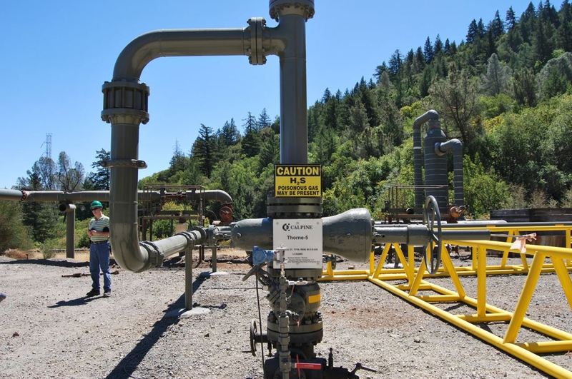
Subsurface Injection
Injection of production brine into deep rock formations
Faster method of disposal
Less exposure to uncontrolled variables
Lower risk of spill
Often used to enhance production by maintaining formation pressure and flushing hydrocarbons from depleted formations – can increase production 2-3 times

Slide 12
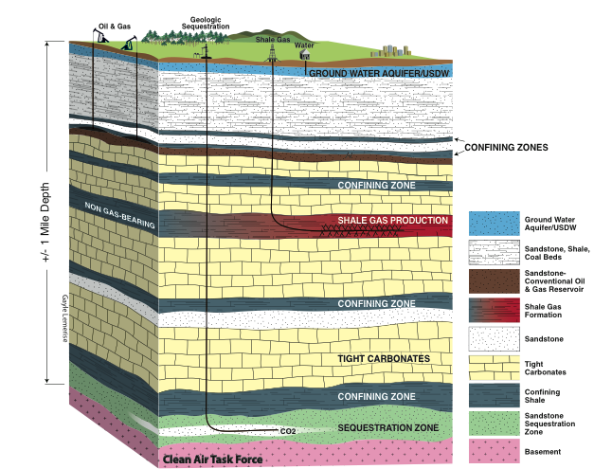
Injection Well Diagram

Slide 13
Subsurface Injection Timeline
1910s
1919 – Texas begins regulating production operations and appoints Texas Railroad Commission (TRRC) as primary regulator for hydrocarbon production and pipeline transportation
1930s
The first documented project for the disposal of brine into the originating formation began in Texas
Enhancing the recovery of oil by injecting water or other fluids into a formation to extract additional oil and gas begins
1940s
Oil refineries begin to inject liquid wastes

Slide 14
Subsurface Injection Timeline (cont.)
1950s
1955 – Texas regulates disposal of production brine
Many other states establish regulations for the disposal of brine
Chemical companies begin to inject industrial waste
1960s
1961 – Texas enacts Injection Well Act to regulate injection wells
Deep well injection in Colorado causes earthquakes
First documented cases of contamination of underground drinking water sources by injection wells

Slide 15
Subsurface Injection Timeline (cont.)
1970s
Waste spill from an abandoned oil well is traced to a nearby injection well
1974 – U.S. enacts Safe Drinking Water Act in 1974 to regulate potential pollution sources of underground drinking water, including injection wells.

Slide 16
Texas Railroad Commission
Established 1891 – oldest regulatory agency in Texas government
3 commissioners elected in statewide elections for 3 year staggered terms
Primarily Texas regulator for energy industry
Hydrocarbon production
Pipelines
Mining
Alternative energy sources
Does not regulate railroads

Slide 17
Texas Injection Well Act
Currently codified as Chap. 27 of Texas Water Code
Regulates all forms of underground injection, including oil & gas production waste liquids
Establishes permit requirement
Requires notice to affected parties
Provides for public hearing to address objections regarding permit applications
Grants TRRC very broad authority to adopt rules to implement statute

Slide 18
Texas Injection Well Act (cont.)
In order to issue permit, TRRC must find:
The proposed well is in the public interest
The proposed well will not compromise any hydrocarbon or other mineral formation
The proposed well makes adequate provisions to protect groundwater and surface water
The applicant has sufficient financial resources to meet its obligations as operator of the proposed well

Slide 19
U.S. Safe Drinking Water Act
Codified at 42 U.S.C. §300f et seq.
Primary regulations for drinking water quality and water suppliers for all U.S. states
Administered by U.S. Environmental Protection Agency (EPA)
Regulates injection wells as an incidental threat to underground freshwater supplies
Beginning in 1979, the EPA develops the Underground Injection Control (UIC) program to regulate injection wells

Slide 20
Underground Injection Control Program
As a result of state regulations and regulators that pre-existed the Safe Drinking Water Act, UIC program provides an option for a state regulator to be the primary regulator of injection wells in that state
States that desire to be the primary regulator of the UIC program apply to the EPA
State regulations must be at least as stringent as EPA regulations
The TRRC is the primary regulator of the UIC program in Texas
32 other U.S. states are primary regulators and 7 other states share authority with the EPA

Slide 21
UIC Program Primacy Map

Slide 22
UIC Program Well Classes

Slide 23
Interaction of U.S. and State Regulations
Both U.S. federal and state regulatory programs are applicable in Texas
UIC Program regulations under the U.S. Safe Drinking Water Act
TRRC regulations under Texas Injection Well Act
In Texas, the TRRC is the primary regulator for both the UIC Program and the TRRC regulations
Permits issued by the TRRC are effective as Class II well permits under the UIC Program
In other U.S. states, the EPA or a state regulator may be the primary regulator (or the EPA and state regulator may share authority)

Slide 24
Types of Class II Wells
Enhanced Recovery Wells inject brine, water, steam, polymers, or carbon dioxide into hydrocarbon formations to enhance production.
Disposal Wells inject brines and other fluids associated with hydrocarbon production for long-term disposal.
Hydrocarbon Storage Wells inject hydrocarbons in underground formations for temporary storage
Distribution of well types
~151,000 Enhanced Recovery Wells (~80%)
~21,000 Disposal Wells (~20%)
~100 Hydrocarbon Storage Wells

Slide 25
U.S. State Injection Well Data
U.S. states with highest number of Class II wells in 2011
Texas – 52,501 (530.2 MMbbl crude oil produced - #1 U.S. state)
California – 47,624 (194.2 MMbbl - #3)
Kansas – 15,919 (41.5 MMbbl - #9)
Oklahoma – 10,854 (77.9 MMbbl - #5)
Illinois – 7,858 (9.2 MMbbl - #14)
Wyoming – 5,005 (54.7 MMbbl - #8)
New Mexico – 4,616 (71.3 MMbbl - #6)
Louisiana – 3,676 (69.0 MMbbl - #7)

Slide 26
Permitting Process and Operations
26

Slide 27
Objectives of Permitting Process
Provide information with permit application that allows TRRC staff to assess the proposed well
Protection of groundwater
Protection of surface landowners
Protection of hydrocarbon producing formations
Notification of interested parties to allow investigation and protest
Broader notification requirements if the proposed well will be used to dispose of brine produced by other operators for a fee (Commercial Disposal Well)

Slide 28
Overview of Permitting Process
Provide notice to interested parties & publish in local newspaper
File application and required supplemental information
Pay application fees
TRRC staff reviews the application
Permits are generally issued within 45 days of filing a complete application (unless protested)
Permit must be issued before drilling or injection can commence

Slide 29
Application Forms
Form W-14
Application for well to dispose brine into a geologic formation that does not have past or current production of hydrocarbons within a 2 mile radius of the proposed injection well (a Non-Productive Formation)
Form H-1/H-1A
Application for well to dispose brine into a geologic formation with past or current production of hydrocarbons within a 2 mile radius of the proposed injection well (a Productive Formation)
Also used to apply for well that is capable of disposal into both Productive and Non-Productive Formations

Slide 30
Application Fees
Wells in Productive Formations - $500 per well
Wells in Non-Productive Formations - $100 per well
Additional fee for each exception requested - $375
Fees are not refundable

Slide 31
General Permitting Requirements
Operators of proposed wells are required to address the following areas of concern through the permit process:
Determine the maximum depth of groundwater sources that require protection (Base of Useable Quality Water)
Determine that the geology in the area of the proposed well has appropriate segregation
Determine the appropriate Area of Review for existing wells or other issues that may compromise the proposed well
Provide interested parties notice regarding the proposed well

Slide 32
General Permitting Requirements (cont.)
Publish required notice regarding the proposed well
Determine the depth of Surface Casing required to protect groundwater sources
Determine the depth of Production Casing required to isolate the well from formations that will not be used for injection
Determine the appropriate placement of Tubing and Packers to isolate the formation that will be used for injection
Determine appropriate surface facility safety and security measures

Slide 33
Permit Processing
Preliminary Review - In order for the permit application to undergo technical review, the operator of the proposed well must meet requirements:
The operator applicant must have a current organization report on file with the Commission and be in good standing
The operator applicant must be the current operator of the lease containing the proposed well
Technical Review – The TRRC technical staff must review applications within 30 days to insure complete information is provided and all permit requirements have been met
If the application is complete and satisfies all permit requirements, the staff will notify the applicant that the application is complete
If the application is incomplete or does not satisfy all requirements, the staff will request additional information

Slide 34
Permit Processing (cont.)
Request for Additional Information
The TRRC staff will send a letter to the applicant requesting the additional information
The staff has up to 30 days to evaluate any additional information filed by the operator
If the application is not completed after 2 requests for additional information, permit application will be denied
Final Review – After the complete application is filed and the preliminary and technical reviews are complete, the TRRC has 15 days to complete any final review and issue an approval or denial of the application
If an application is denied, the applicant may appeal the denial to the full TRRC

Slide 35
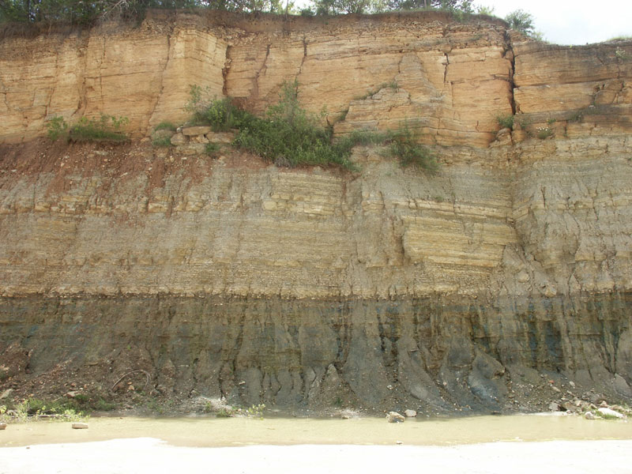
Essential Geological Requirements
The injection formation of the proposed well must be isolated from usable quality groundwater and hydrocarbon production formations by a relatively impermeable rock formation generally at least 250 ft. thick

Slide 36
Well Log
The applicant must submit an electric well log to identify the injection formation and segregating formations of impermeable rock
Electric well logging tests the electrical resistivity of the formations contacted by the well to identify the depth and thickness of each formation
If a well log is not available for the proposed well, the applicant may submit a log of a nearby well and identify the logged well on the area review map submitted with the application

Slide 37
Well Log Example

Slide 38
Groundwater Depth Determination
Application must include a letter issued by the Groundwater Protection Unit of the TRRC (GPU) that determines the Base of Usable Quality Water in the area of the proposed well
The Base of Usable Quality Water defines the lowest depth of useful groundwater for human/animal consumption and agricultural irrigation
Base of Usable Quality Water is determined by the GPU based on case-by-case reference to government database of information

Slide 39
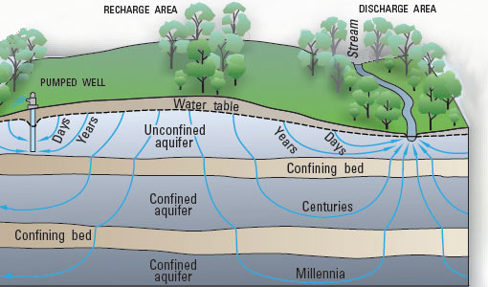
Types of Aquifers
Unconfined aquifers are generally closest to the surface and most often used for human/animal consumption and agricultural irrigation
Confined aquifers are separated by impermeable rock layers. found in deeper depths They may be salinated to lesser degrees than brine or have other natural contaminants

Slide 40
Base of Usable Quality Water Variance
300 ft.
700 ft.
100 ft.
1,275 ft.
800 ft.
1,500 ft.
250 ft.
1,650 ft.
3,900 ft.

Slide 41
Review of Area Wells
The permit application must include an analysis of all existing wells that penetrate the proposed injection formation within a ¼ mile (~400m) radius of the proposed well
Confirm existing wells are active and correctly functioning wells or have been plugged in a manner that will prevent the movement of fluids into formations other than the authorized injection formation
Application must include a map all wells within a ¼ mile radius of the proposed well showing the total depth of each well

Slide 42
Review of Area Wells (cont.)
Application must include a table including information for each well within the ¼ mile radius:
Lease name and number
Well number
API number
Total depth
Date drilled
Current status and plug date (if applicable)

Slide 43
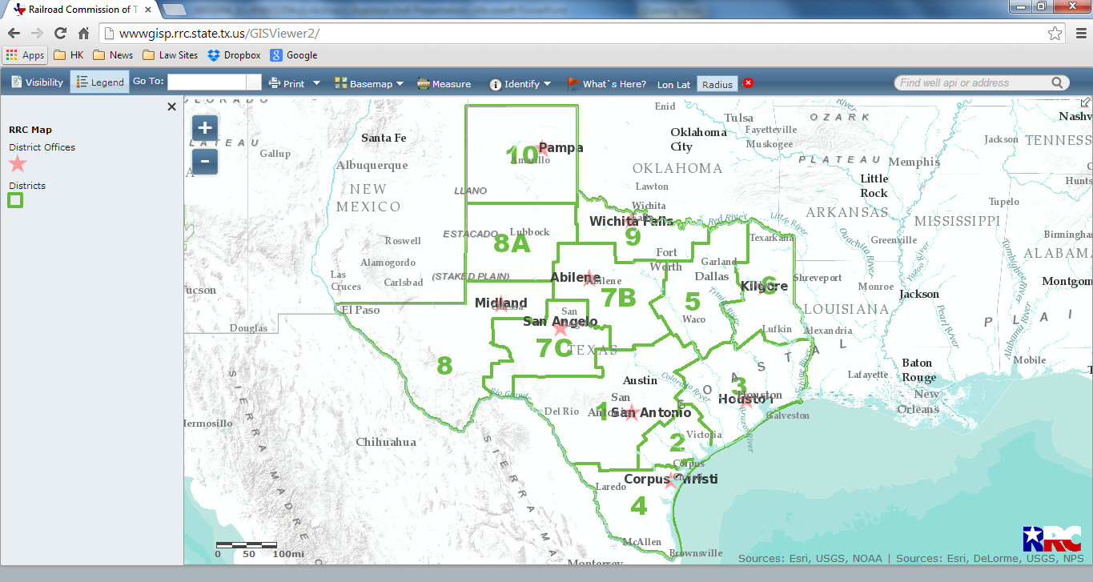
TRRC Well Mapping Application

Slide 44
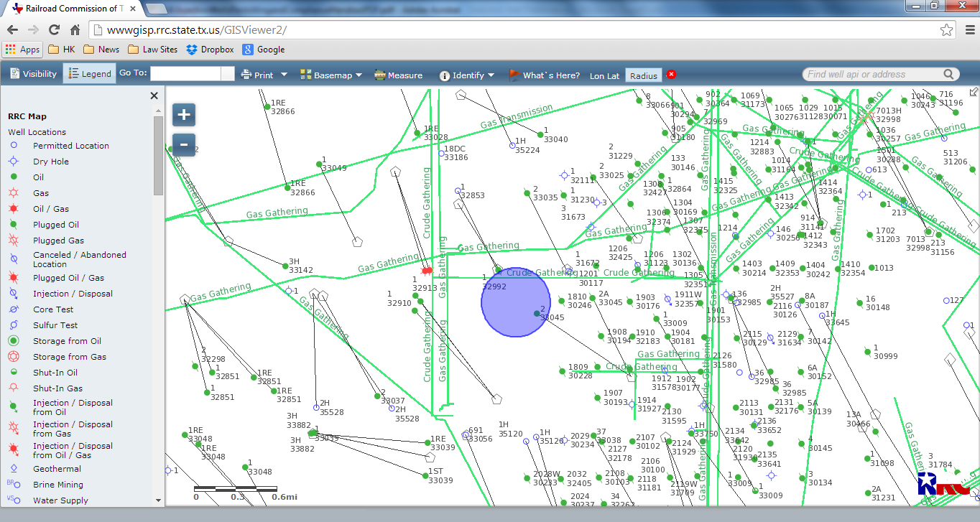
TRRC Well Map

Slide 45
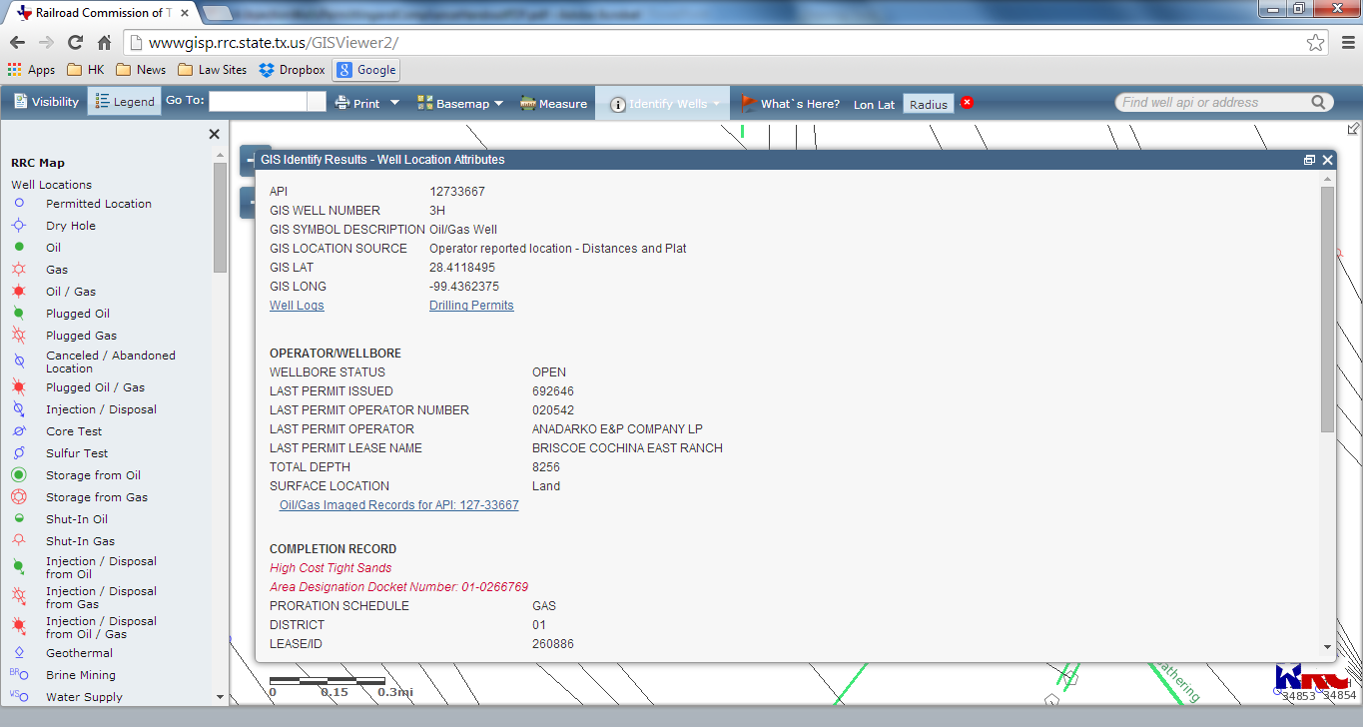
TRRC Well Map

Slide 46
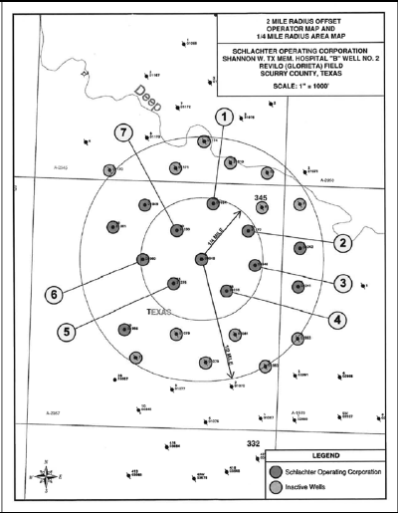
Example of Application Well Map

Slide 47
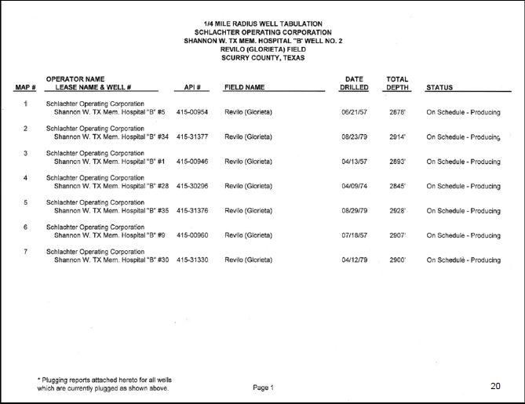
Example of Application Well Information Table

Slide 48
Notice to Interested Parties
A complete copy of the completed permit application form must be mailed or delivered to the following interested parties:
The surface owner of record (as recorded in county deed or tax rolls)
Adjoining surface owners of record (if application is for a commercial disposal well)
All operators of other wells within ½ mile (~800m) radius of the proposed well

Slide 49
Notice to Interested Parties (cont.)
The county clerk
The city clerk if the proposed well is located within city boundaries
The TRRC “recommends” including with the notice a cover letter that explains the nature of the application
Applicant must submit a signed statement listing name, address, and basis for interest (e.g. surface owner, nearby operator, etc.) and the date that a copy of the application was mailed or delivered to each interested party

Slide 50
Publication
Notice of the application must be published once on the day before permit application is filed in a newspaper of general circulation in the county where the prospective well is located
Formation, field, lease and whether the target formation is productive or non-productive of oil and gas
Description and depth of the injection formation
Well number
Direction and distance to the nearest town
Instructions regarding how to obtain further information or protest the application

Slide 51
Publication (cont.)
Applicant must submit the following information with the application:
Notarized affidavit of publication and a certification that the newspaper has general circulation in the county where the proposed well is located
Newspaper clipping.

Slide 52
Example of Published Notice
NOTICE OF APPLICATION FOR FLUID INJECTION WELL PERMIT Kinder Morgan Production Co LLC has applied to the Texas Railroad Commission for permit to inject fluid into a formation which is productive of oil or gas. The applicant proposes to inject fluid into the Strawn Sandstone formation, Katz (Strawn) Unit, well 442. The proposed injection well is located 16.8 miles Northeast of Old Glory, Texas in the Katz (Strawn) Field, Stonewall County. Fluid will be injected into strata in the subsurface depth interval from 4750’ to 5600’. LEGAL AUTHORITY: Chapter 27 of the Texas Water Code as amended, Title 3 of the Natural Resources Code, as amended, and the Statewide Rules of the Oil and Gas Division of the Railroad Commission of Texas. Requests for a public hearing from persons who can show they are adversely affected or requests for further information concerning any aspect of the application should be submitted in writing within 15 days of publication to the Underground Injection Control Section, Oil & Gas Division, Railroad Commission of Texas, P.O. Drawer 12967, Capitol Station, Austin, Texas 78711. Phone: 512/463-6792.

Slide 53
Wellbore Protection Components
The applicant must submit information regarding the placement of casing, tubing and packers for review by TRRC staff
Surface Casing – shallowest and thickest level of casing principally used to protect groundwater
Intermediate casing – casing sometimes used (particularly in deeper wells) to strengthen the wellbore
Production casing – casing used to protect the injection formation
Tubing – injection tubing that delivers the injected fluid to the injection formation
Packer – blocking collar that prevents backflow of fluid between the tubing and production casing

Slide 54
Casing Diagram

Slide 55
Surface Casing
The TRRC has determined that injection wells carry inherently higher risk to groundwater than production wells and should have the maximum level of groundwater protection
Generally, surface casing must be set to the Base of Useable Quality Water determined by the Groundwater Advisory Unit of the TRRC and cemented to the surface
With respect to an existing production well that is proposed to be converted to an injection well, if the existing surface casing does not extend through the Base of Useable Quality Water, the TRRC may approve an injection permit with additional protection and increased testing and monitoring

Slide 56
Examples of Surface Casing Depth Variance

Slide 57
Production Casing
Production casing must be set through the injection formation and cemented from the casing shoe to 400-600 ft. above the top of the injection formation.
Since January 1, 2014, casing must also be cemented across and above all productive formations, potential flow zones, and zones producing corrosive fluids

Slide 58
Tubing and Packer
Generally, all proposed wells must be equipped with tubing set with a packer
Proposed wells permitted to inject into a Non-Productive Formation must have a packer set within 100 ft. above the injection formation
Proposed wells permitted to inject into a Productive Formation must have a packer set within 200 ft. below the top of cemented production casing AND at least 150 ft. below the Base of Useable Quality Water
If there are potentially permeable formations between the proposed packer setting depth and the proposed injection interval, the packer must be set below those formations if the application does not propose injection into those formations

Slide 59
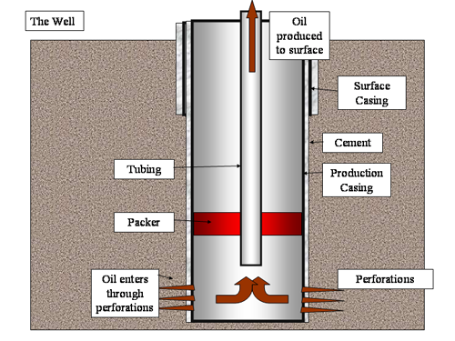
Tubing and Packer Diagram
Water from
surface
Surface
Casing
Cement
Tubing
Production
Casing
Packer
Injected Water through perforation
Perforation

Slide 60
Surface Requirements
In addition to requirements regarding downhole completion, the TRRC requires surface safety and security measures:
Construction of surface facility components (pits, catch basins, brine storage and treatment components, etc.) must meet minimum specifications
Dikes to prevent spill migration must be constructed around all storage, treatment and injection components
The surface facilities must have security measures to prevent unauthorized access, including fencing (or other barriers to entry) and a lockable gate
All storage tanks must be equipped with a device (visual gauge or alarm) to alert personnel when the tank is within 130 barrels of its capacity

Slide 61
Protest & Hearing
An interested party that objects to the creation of the proposed well may protest and request a hearing
Protest must be filed within 15 days of receipt of notice
Protesting party must show that it has or will suffer actual injury or economic damages as a result of the well
Members of the general public do not have standing to protest the well
Initial hearing is held before an examiner employed by the TRRC

Slide 62
Protest & Hearing (cont.)
The examiner issues a written report that recommends a course of action to the TRRC
The TRRC makes a determination regarding the protest at a public meeting
Full protest generally requires 6-12 months to complete

Slide 63
Post-Permitting Operation Reports
Completion Report – filed within 30 days after completion
Casing and cementing record
Packer depth
Injection zone – must report actual depth of perforation
Indicate if a cement squeeze was performed
Mechanical Integrity Test Report – a successful integrity test must be performed before any fluid injection
Additional integrity tests must be performed at least every 5 years
Annual Monitoring Report provides monthly injection volume for subject year

Slide 64
Takeaways
64

Slide 65
Takeaways
Groundwater protection continues to be a critical issue of concern for both regulators and the public
Subsurface migration of fluids
Disclosure of chemicals contained in injected fluids
Continuing discussion regarding expansion of notification requirements
Groundwater Conservation Districts
Larger area of surface and subsurface owners

Slide 66
Takeaways (cont.)
Geologic variations make accurate data sources critical
Groundwater depth
Geologic formations
Other wells that penetrate to injection formation
Cemented casing is regarded as the best protection for well integrity
Surface casing through full depth of groundwater
Production casing through all injection and production zones

