Slide 1
Oil and Gas Exploration and Production Activities Impacting Wetlands – Case Studies
Paul R. Krause, Ph.D.
Knowledge Management Program
Sensitive Ecosystem Workshop Bogota, Colombia November 2012

Slide 2
E&P Impacts to Wetlands – Case Studies
E&P Development Within Wetlands
Niger River Delta
Southern USA
Offshore E&P Impacts to Wetlands – Oil Spills
IXTOC – 1979
Deepwater Horizon – 2011

Slide 3
E&P Development Within Wetlands - Niger River Delta
The world’s leading sustainability consultancy

Slide 4
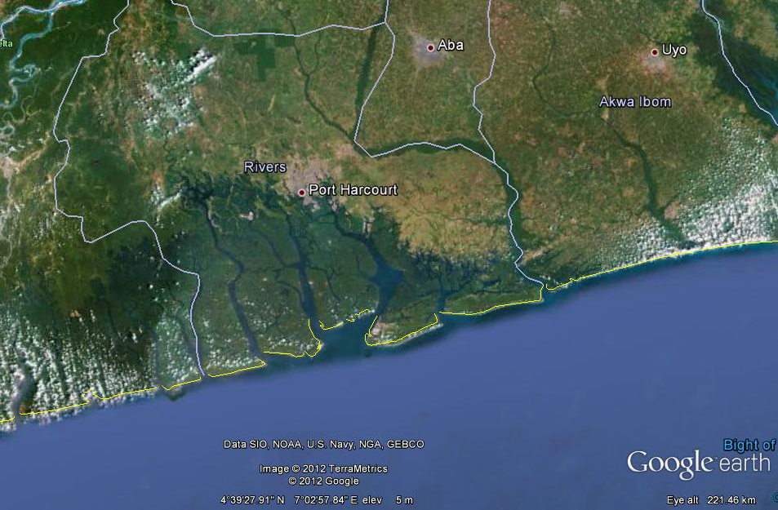
Niger River Delta
One of the worlds largest wetland environment impacted by oil and gas development activities over many years.
Basic Facts:
Covers over 70,000 km2
7.5% of Nigeria’s land mass
Covers 8 Nigerian States
31 million people
Over 40 ethnic groups
Ecologically one of the most productive ecosystems on Earth.

Slide 5
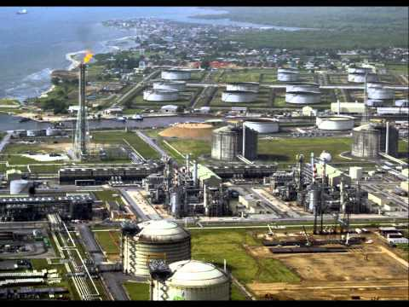
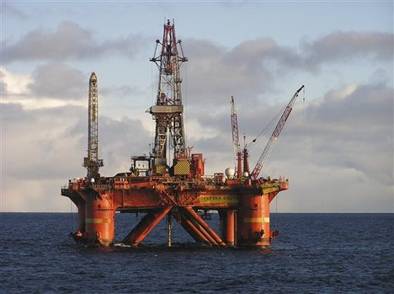
Niger River Delta
Oil Exploration and Production
Almost every major oil company operates in the delta
All level of operations
Offshore Production
Onshore Production
Refining
Pipelines
Shipping

Slide 6
Niger River Delta
Over the years since E&P activities started in the Delta wetlands, there have been numerous small spills and releases
The most recent occurred 20 November, 2012 with at 32 Km slick in the delta resulting from a pipeline breach
These have affected both the ecology and population of the region
To date there has been little restoration activity in the Delta and the local Governments address impacts within their jurisdiction

Slide 7
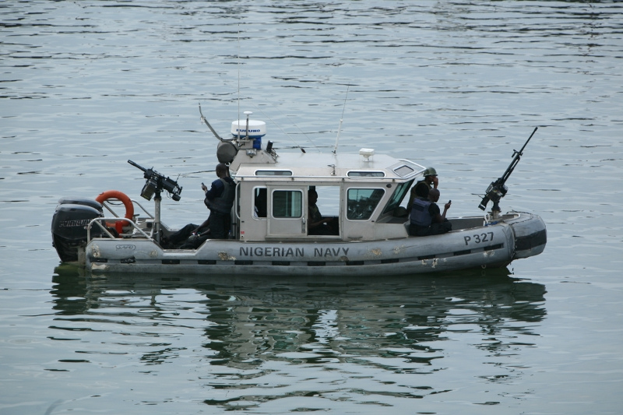
Niger River Delta
The local population has become politically active and there has been widespread periods of unrest
This has led to security issues at all E&P sites
Security has required substantial input from Nigerian military sources
Issues include:
Kidnappings
Pipeline breaches
Infrastructure damages
Environmental impacts of E&P activity is often not a priority

Slide 8
E&P Development Within Wetlands - USA Gulf of Mexico
The world’s leading sustainability consultancy

Slide 9
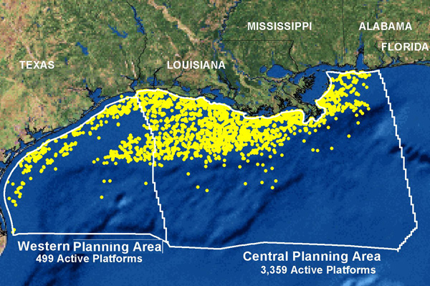
USA Gulf Coast
The southern Gulf Coast of the United States contains the largest concentration of E&P activities, and the largest area of coastal wetlands
Basic Facts:
Covers 5 US States
20 million people
Mississippi River Delta and coastal wetlands
23% of US oil and 7 % of gas production
over 3800 offshore oil and gas production facilities

Slide 10
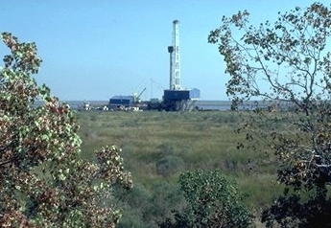
USA Gulf Coast
US Federal and State resource agencies regulate oil and gas activities within each State and in Federal waters of the Gulf of Mexico.
Impacts associated with E&P in wetlands can be widespread and on-going activities include:
Infrastructure development
Platforms, drilling pads (offshore/onshore)
Tank farms
Ports and shipping terminals
Refining

Slide 11
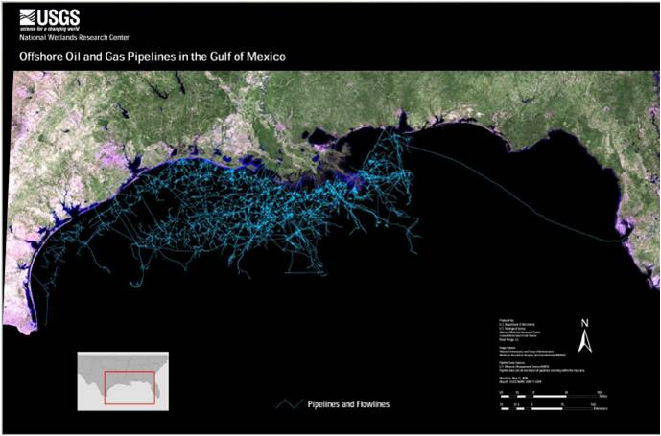
USA Gulf Coast

Slide 12
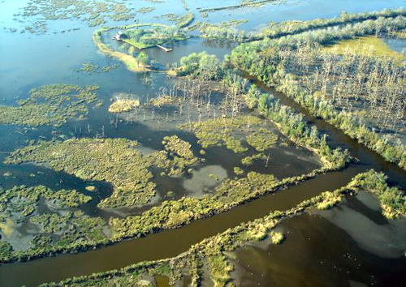
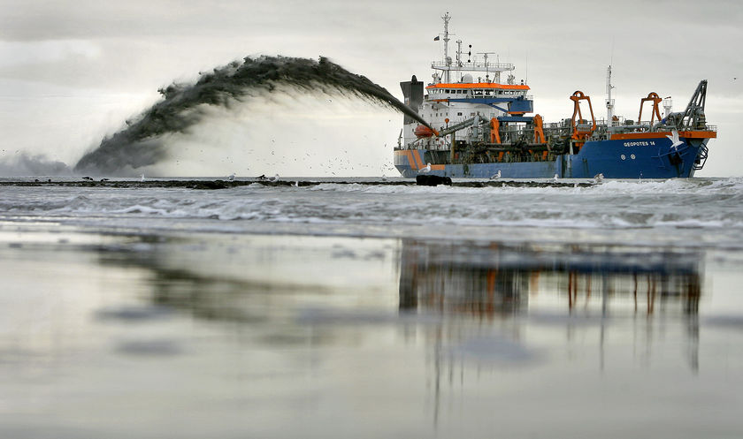
USA Gulf Coast
Overall impacts to wetlands is minimal throughout the Gulf States from E&P activities
Several types of impacts observed in the Gulf of Mexico wetlands:
Spills – direct and indirect impacts
Infrastructure related - Dredging Impacts
Channelization of wetlands
Water availability
Fill of wetlands
Land creation
Aquatic habitat loss
Road and pipeline crossings
Increased human populations
Increased erosion

Slide 13
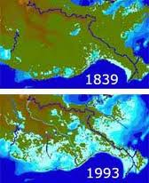
USA Gulf Coast
The largest impact has been natural - Erosion
Typical causes of coastline erosion
Hurricane and Storm Activity
Decreased water flow from rivers
Upstream water use
Dams
Diversion systems
E&P activities that may impact erosion are important to monitor and mitigate
Mississippi River Delta Erosion 1893-1993

Slide 14
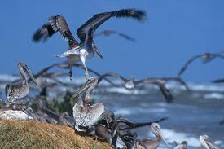
USA Gulf Coast
Mitigation measures for E&P activities within wetlands are regulated by both Federal and State agencies
Mitigation banks have been set up in all Gulf States for wetlands
Projects are managed by individual states or NGOs
Mitigation projects can range from restoration of impacted areas to other compensatory actions
Artificial reefs
Wildlife care networks
Seed and plant propagation programs
Other mitigation measures used in the region include:
Development of Best Management Program (BMP) for erosion control
Replacement of dams and culverts for wildlife passage

Slide 15
Offshore E&P Impacts to Wetlands - Oil Spills
The world’s leading sustainability consultancy

Slide 16
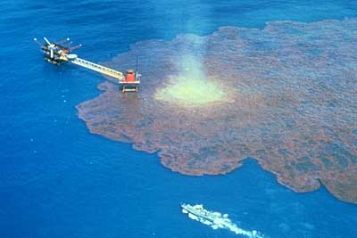
Oil Spills – IXTOC - 1979
3 June, 1979
Loss of control of an exploratory well head
Sedco 135F Platform from Pemex
Bahia de Campeche,
Approximately 100 km NW of Ciudad del Carmen
50 m water depth
Flow for 10 months
Subsurface relief well
480,000 m³ of oil released (3,000,000 bbl)
Surface slick cover 2,800 km²

Slide 17
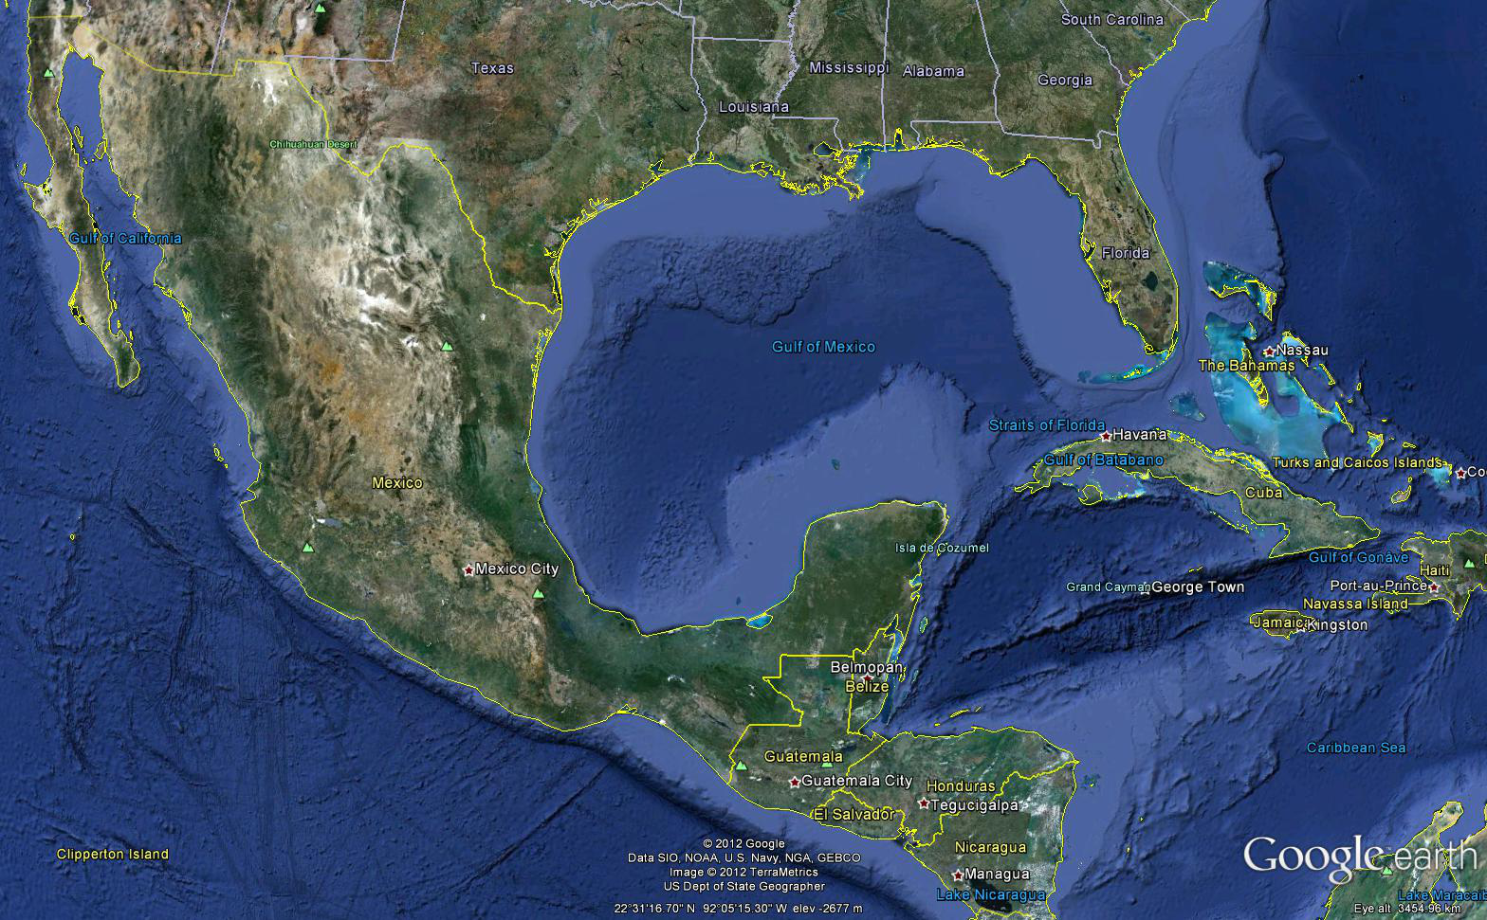
Oil Spills – IXTOC - 1979

Slide 18
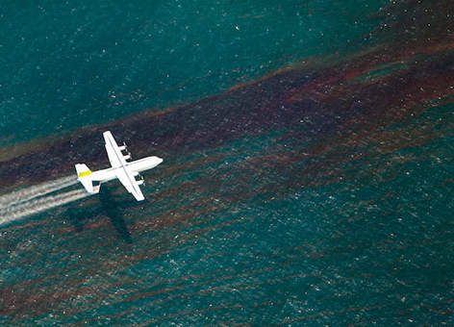
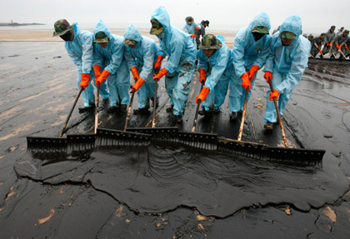
Oil Spills – IXTOC - 1979
IXTOC occurred very early in the development of effective spill response technology
The slick was treated with dispersants from aircraft
This, and the warm climate, resulted in rapid weathering of the oil
The impacted areas Included:
Sandy beaches requiring mechanical and hand removal of oil
Wetland habitats along the Mexican coastline
Approximately 260 km of US beaches were affected

Slide 19
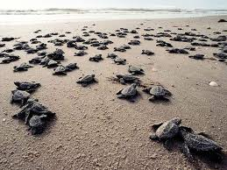
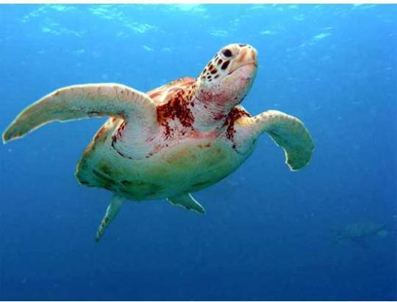
Oil Spills – IXTOC - 1979
Oil penetrated wetlands along the Mexican coastline
Efforts for wetland clean up were minimal
Long term monitoring of the wetlands has indicated that since the spill wetlands have recovered naturally.
Little evidence of the spill exits today
Rancho Nuevo, in Tamaulipas, Mexico
The beach was impacted by oil.
Main nesting ground for the Critically Endangered Kemp’s Ridley sea turtle.
Efforts were made to protect the species and the population is stable with little sign of IXTO effects on the population.
Included airlifting eggs from nests to non-impacted beaches.

Slide 20
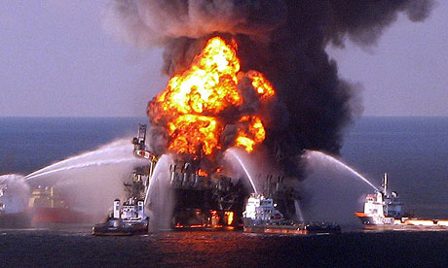
Oil Spills – Deepwater Horizon - 2010
20 April, 2010
Loss of control of an exploratory well head
Deepwater Horizon Platform from BP/Transocean
Mississippi Canyon, Gulf of Mexico
Approximately 66 km SE of Biloxi, MS
1500 m water depth
Flow for 5 months
Subsurface relief well
780,000 m³ of oil released (4,900,000 bbl)
Surface slick cover 10,000 km²

Slide 21
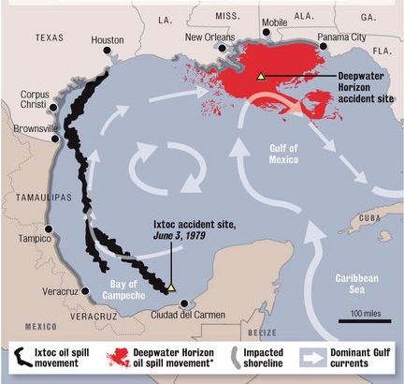
Oil Spills – Deepwater Horizon - 2010

Slide 22
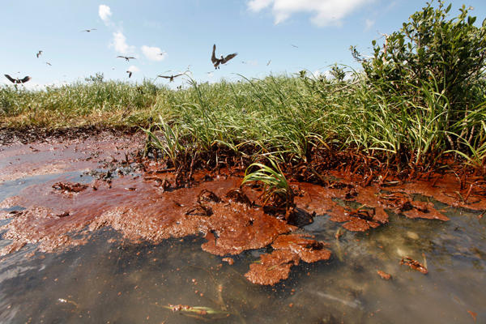
Oil Spills – Deepwater Horizon - 2010
Following the Exxon Valdez disaster in 1989, the science of spill response and the technology to fight oil spills has greatly improved.
All modern method to fight the spill were used.
Dispersants
Containment
Physical removal
In-Situ Burning

Slide 23
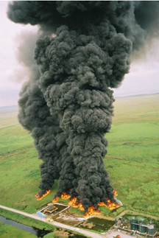
Oil Spills – Deepwater Horizon - 2010
Wetland clean up and restoration activities continue to this day
Key Lessons Learned
Mechanical mechanisms for removal of oil are only marginally successful
Absorbent boom
Vacuuming
Washing
Burning of oil is very successful in removal of oil mass
At sea
In wetland
Oil penetration into the wetland was less than expected

Slide 24
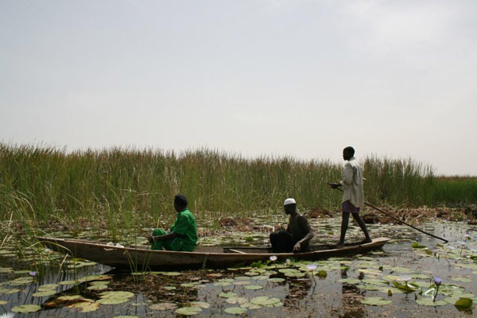
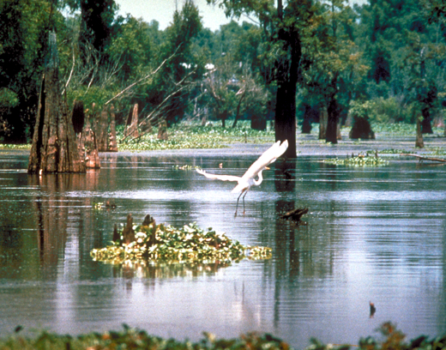
Case Studies – Summary
Niger River Delta
Poor control of resources
Widespread environmental damage
Population unrest
Instability for region
US Gulf Coast
Largest density of E&P activity
Very little environmental damage
Large amount of regulation
Good use of mitigation and monitoring
Active management of resources

Slide 25
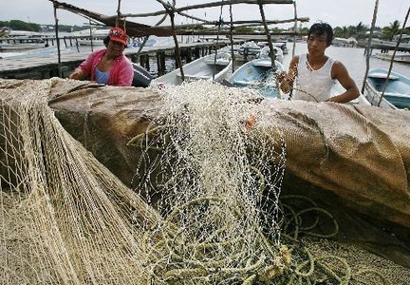
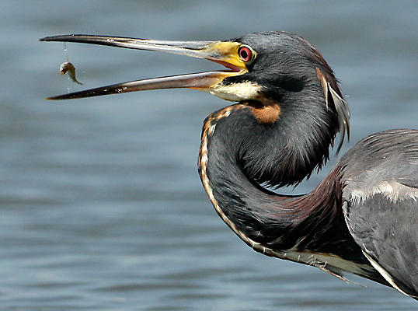
Case Studies – Summary
IXTOC Spill
Early response
Effected US coast more than Mexico
Wetlands impacted directly in Mexico
Good wetland recovery
Good beach recovery
Deepwater Horizon
Best available technology
Wetland effects were minimal
On going recovery efforts
Restoration
Monitoring and mitigation

Slide 26
Case Studies – Conclusions
Oil and gas exploration and production can be done in wetland ecosystems with minimal environmental impacts.
Requires advanced planning and strong impact analysis.
Avoid the mistakes of the past.
Develop strong mitigation and monitoring programs before the project gets started
Mitigation banking
Spill response
Contingency Planning

Slide 27
Effects on Wetland Function or Service
Any Questions?

Slide 28
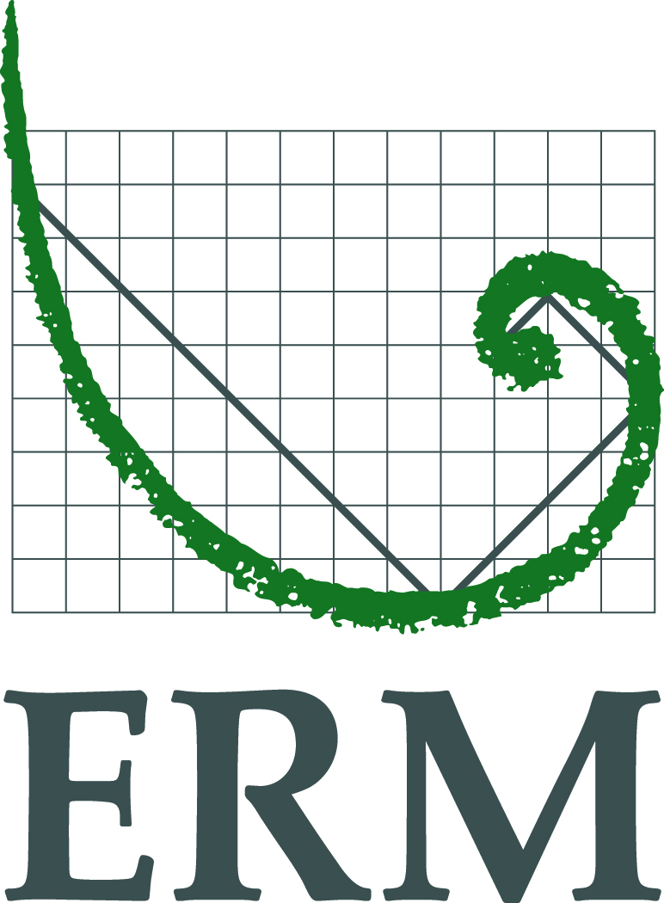
www.erm.com

