Slide 1
Sustainable Development: Producing Energy While Protecting the Environment
Dave Neslin
Davis Graham & Stubbs LLP
Former Director of the Colorado Oil & Gas Conservation Commission
Environmental and Social Challenges of E & P Activities in Unconventional Hydrocarbon Reservoirs
December 3 – December 5, 2012
Bogata, Colombia

Slide 2
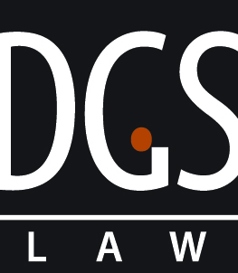
The U.S. has numerous unconventional gas plays
2

Slide 3
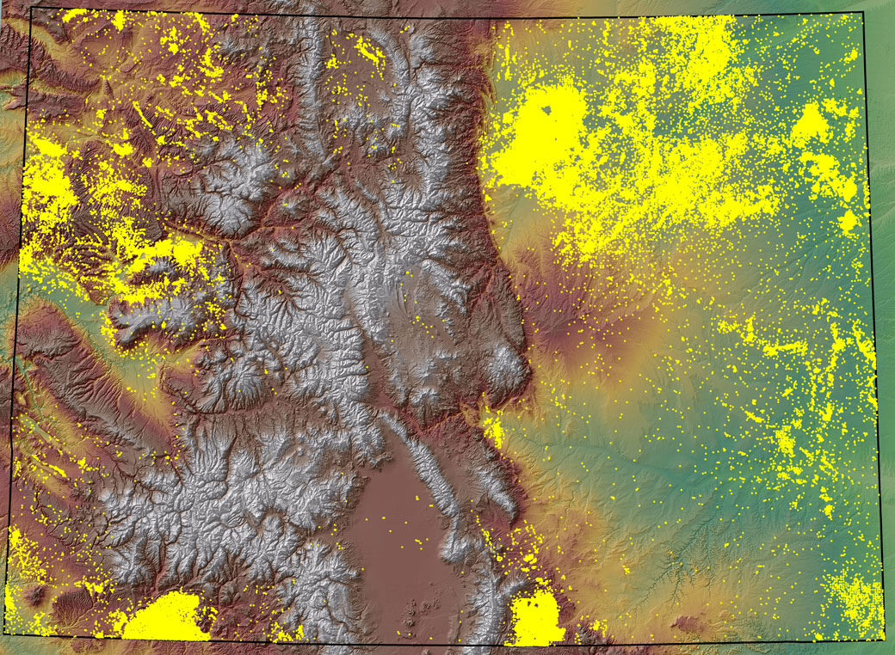
As does Colorado
Piceance
Denver-
Julesberg
Raton
San Juan
Colorado is about one-quarter the size of Colombia, with tight gas in the northwest, shale gas in the northeast, and coalbed methane in the south.
3

Slide 4
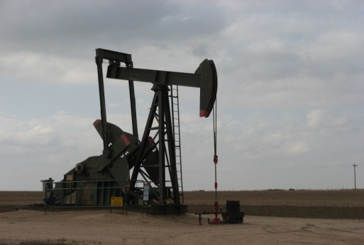
Colorado Is both a Major Oil
and Gas Producer
- 150 year history of production
- 47,000 active wells
- 3,000~ new wells each year
2011 production:
1.68 trillion cubic feet natural gas (5th in U.S.)
39 million barrels oil (9th in U.S.)

Slide 5
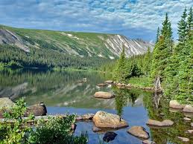
And an International Outdoor Destination
- 55 14,000-foot mountains
- 4 national parks and 41 wilderness areas
- World class wildlife populations
12 million skier visits
1 million+ fishing licenses and 650,000+ hunting licenses

Slide 6
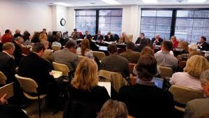
Due to increased activity, Colorado comprehensively updated its regulations in 2008 to increase environmental protection, transparency, and efficiency. It was the most extensive rulemaking in state history.

Slide 7
Developing Draft Rules
8 months
40+ staff involved at 3 agencies (oil and gas, health and environment, and wildlife)
Initial narrative proposal focused and facilitated early public input
Public participation
5 public meetings attended by 1,700 people
37 technical meetings attended by 250 specialists
2000+ written comments
150-page cost benefit analysis

Slide 8
Adopting Final Rules
9 months
Numerous iterations of draft rules
24 days of commission hearings
12+ hours of public comment
80+ hours of testimony by 160 witnesses
80+ hours of deliberations
20,000+ pages of documents

Slide 9
Several things helped make this process successful:
It was legislatively authorized;
It was inclusive; and
The rules were unanimously approved.

Slide 10
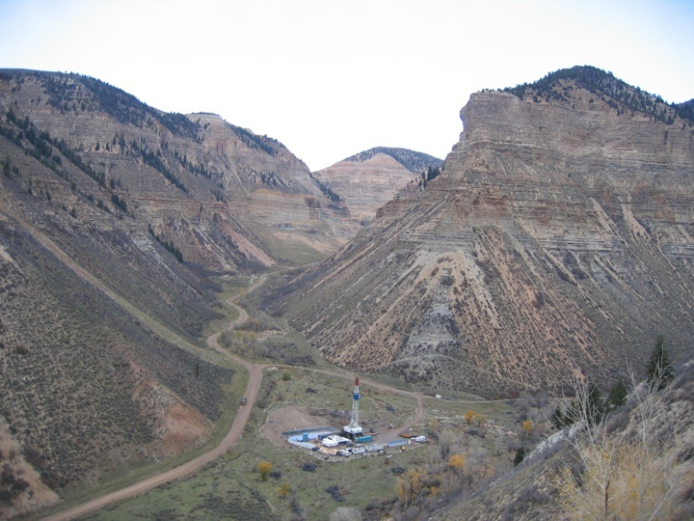
Environmental Standards

Slide 11
Responsibly Regulating Hydraulic Fracturing
Well construction
Chemical disclosure
Groundwater sampling
STRONGER

Slide 12
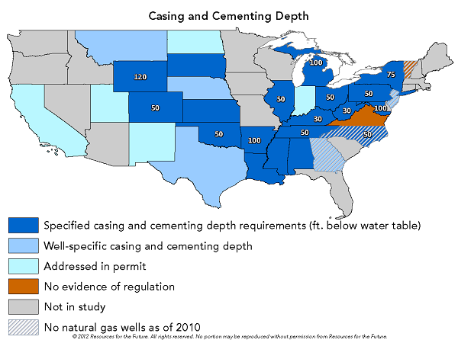
State Casing and Cementing Depths

Slide 13
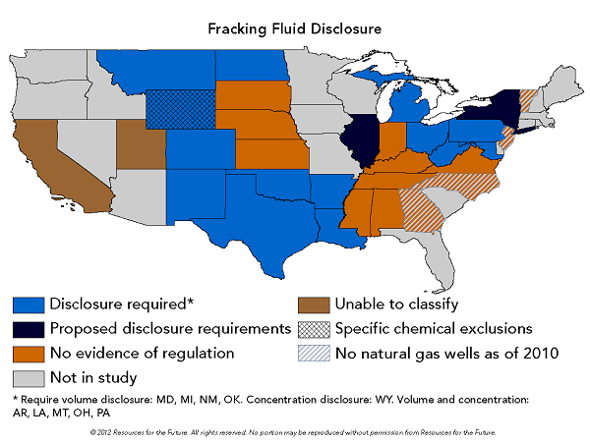
State Fracturing Fluid Disclosure

Slide 14
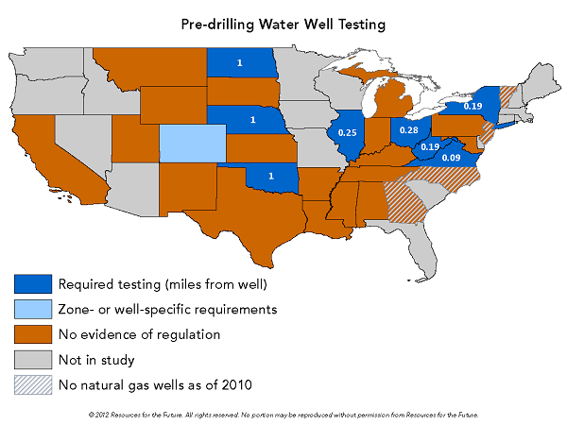
State Groundwater Testing

Slide 15
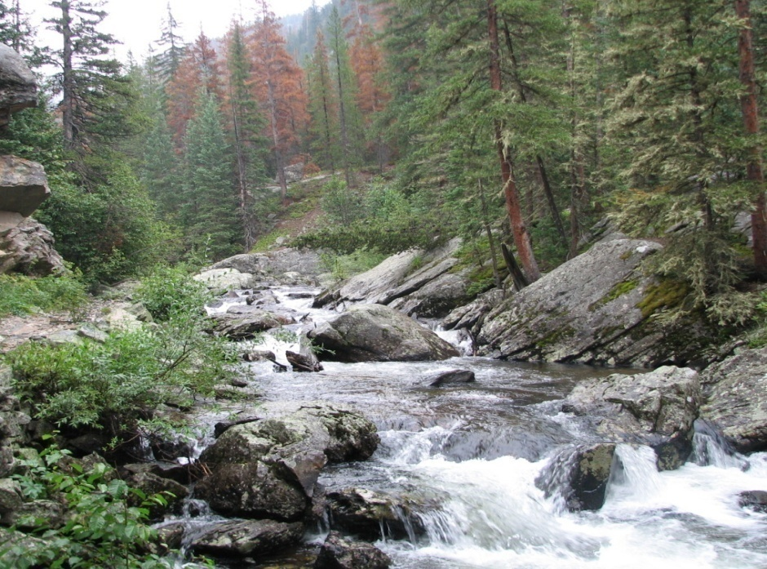
Protecting Water Quality
Waste management
Secondary containment
Spill reporting
soil and ground water standards

Slide 16
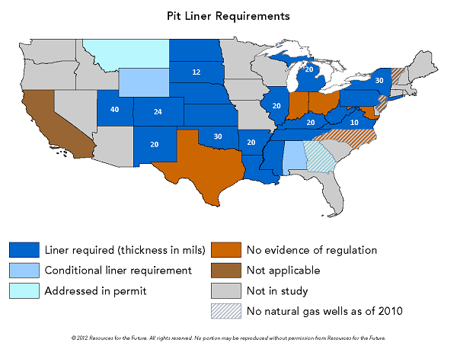
State Pit Liner Requirements

Slide 17
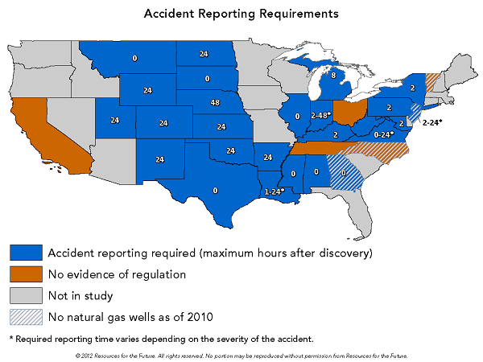
State Spill Reporting Requirements

Slide 18
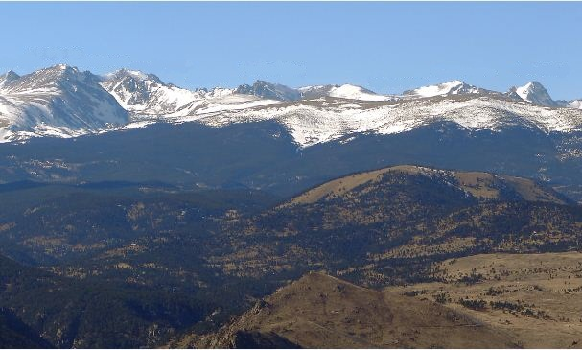
Protecting Air Quality
Green completions required
Emission control devices on certain production equipment
Restrictions on venting

Slide 19
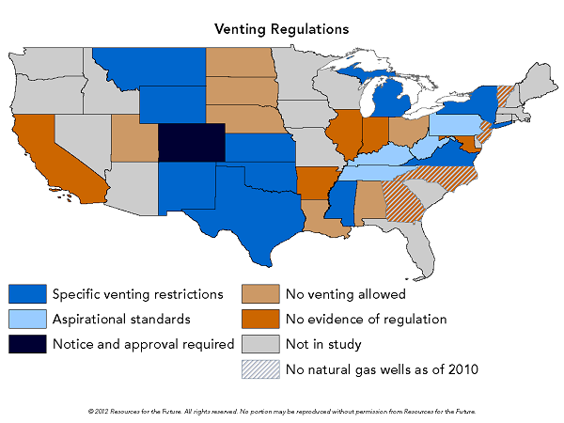
State Venting Regulations

Slide 20
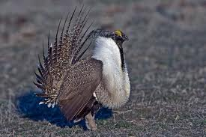
Protecting Wildlife
Avoid the most critical habitat if feasible
Consult with the State on other sensitive habitat
Implement best-management practices and mitigation measures

Slide 21
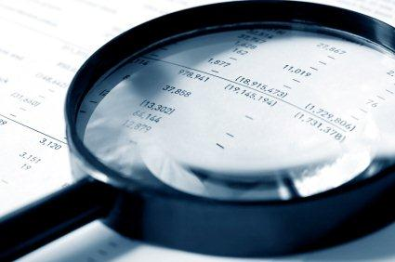
Promoting Transparency
Permit applications posted to the internet
Notice to local governments and nearby surface owners
Opportunity for public comment
Coordination with local governments

Slide 22
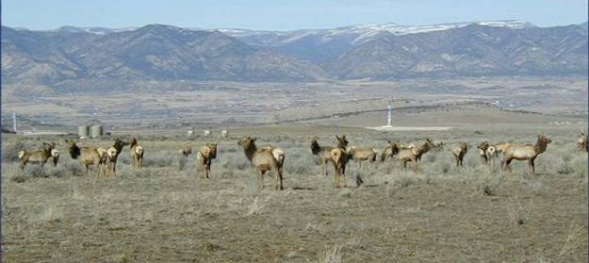
Encouraging Landscape Planning
Tools:
– Geographic area plans
– Comprehensive drilling plans
– Wildlife mitigation plans
Benefits:
– More efficient and predictable results
– Better address cumulative effects
– Facilitate more win-win solutions

Slide 23
Improving Permitting Efficiency
Distinguish between surface and below-ground issues
Add staff and adjust process to eliminate bottlenecks and backlogs
Extend permit duration to two years

Slide 24
Several things helped make these rules successful:
They are tailored to local basin, landscape, and community needs;
They balance prescription with performance; and
They were implemented responsibly.
– Training
– Guidance

Slide 25
Results After Three Years
More Energy Production | More Environmental Protection
30% increase in oil production; 10% increase in gas production; and more new wells started than surrounding states. | Pitless drilling systems increased from 31% to 70%; 61% of fracturing fluid recycled this summer; 85% green completions this summer; Wellsites > 1,000 feet from the closest building increased from 68% to 76%; and 14 wildlife mitigation plans covering 750 square miles of habitat

Slide 26
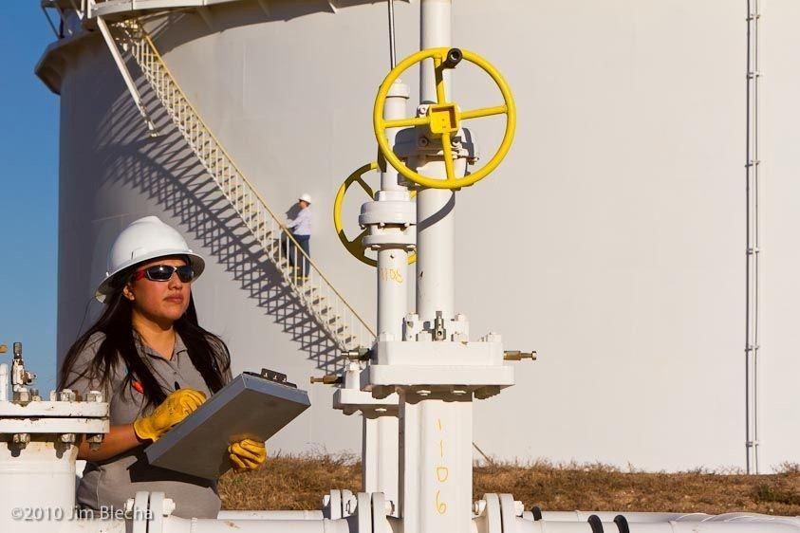
Monitoring and Compliance

Slide 27
Colorado Well Reporting
Reports after drilling:
Casing and cementing
Geotechnical conditions
Reports after hydraulic fracturing:
Fracturing fluid source and disposition
Fracturing pressure
Green completions
Monthly reports:
Gas and water produced
Gas flared
Annual compliance checklists

Slide 28
Colorado Inspections
Colorado Complaints
18 full time inspectors located throughout the state
Over 17,000 inspections in 2010
Most inspections are unannounced
Response within 24 to 48 hours
Water testing and analysis
Right to a hearing

Slide 29
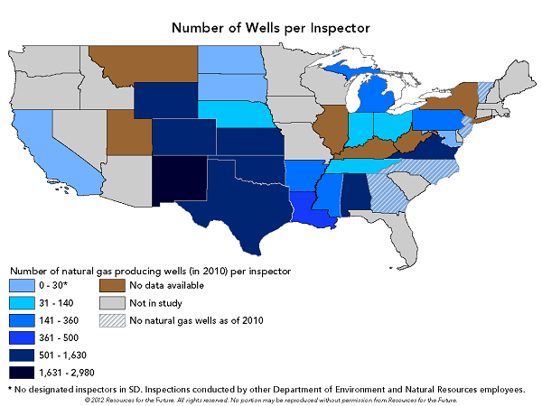
Number of Wells per Inspector

Slide 30
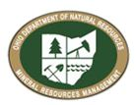
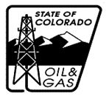
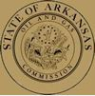
Increasing Regulatory Resources:
As part of this process, states are increasing the size of their regulatory staffs:
Pennsylvania 100% increase
Ohio 100% increase
Colorado 50% increase
Arkansas 40% increase
30

Slide 31
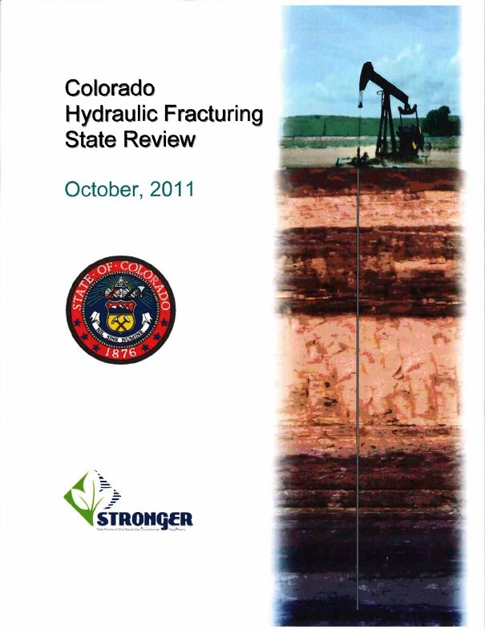
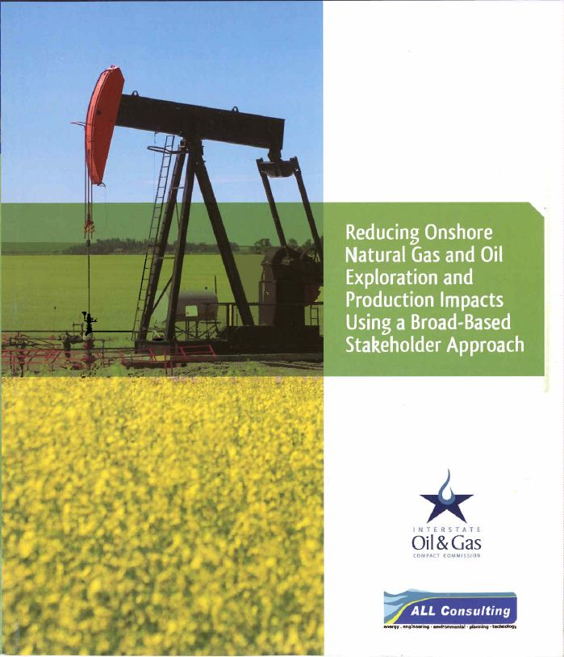
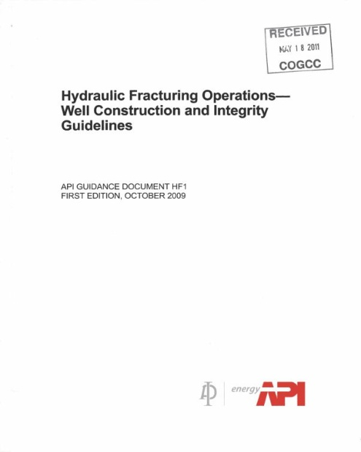
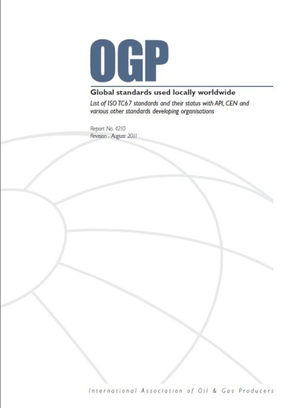
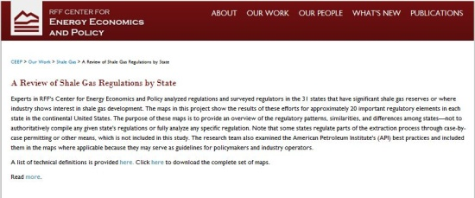
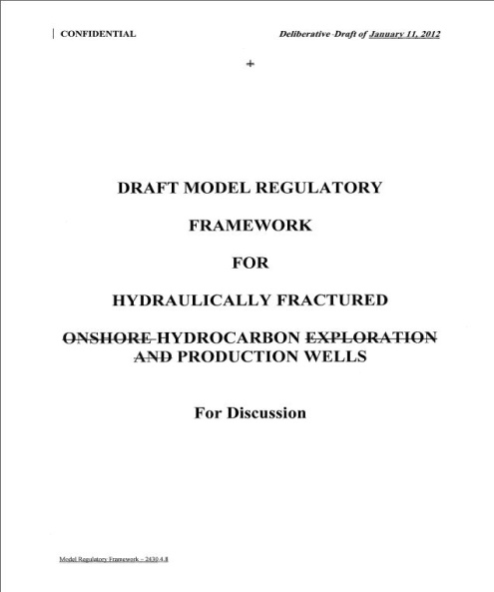
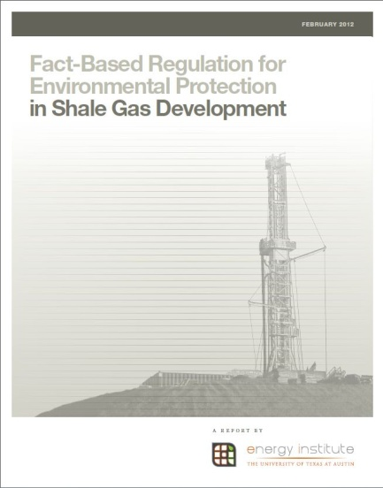
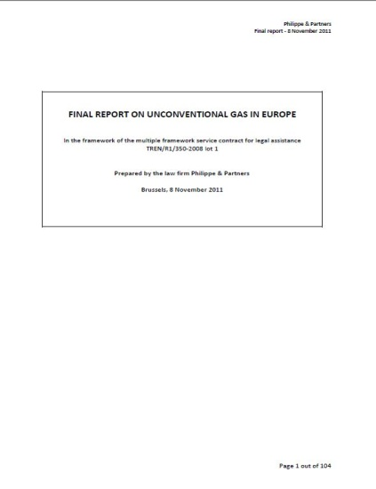
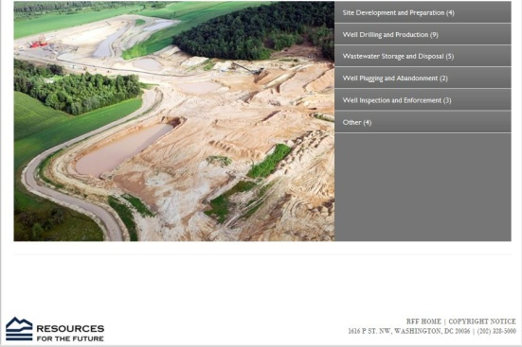
Tools for Improving Performance
31

Slide 32
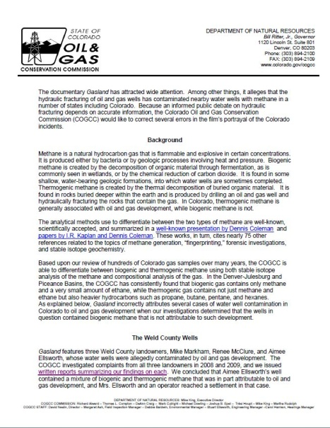
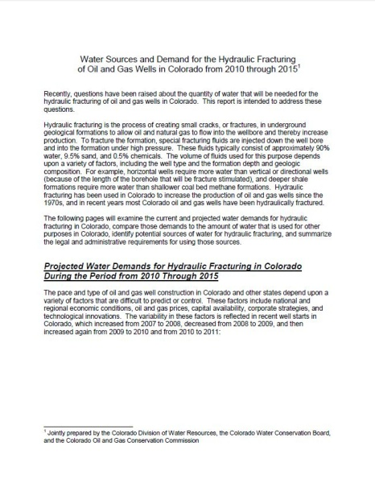
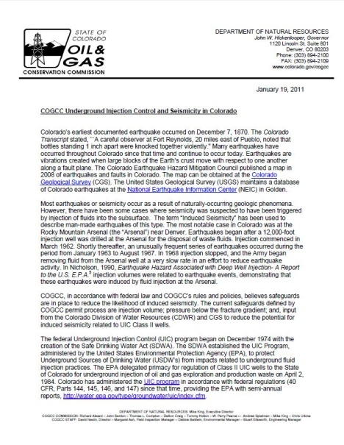
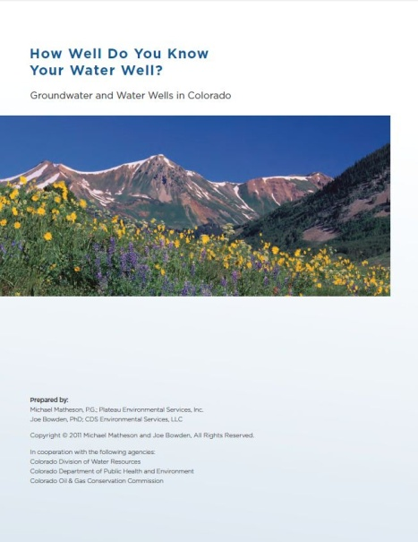
Public Education
Outreach to public and press
Reports on emerging issues

Slide 33
Questions
\\\\\\\\\\
David.neslin@dgslaw.com
Office: 1-303-892-7401
Cell: 1-303-947-7421

