Slide 1
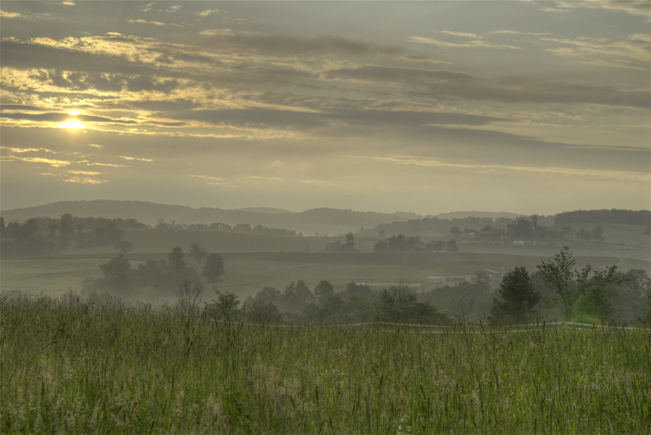
Natural Gas Development from Shale: Socio-Economic and Cultural Impacts
Jon Laughner, EcoPetrol, December 5, 2012
JBLaughner@psu.edu; 724-333-5765

Slide 2
Will this activity affect the source of their livelihood?
Who will benefit?
Notes:
Outsiders?
landowners, industry, small business, local business, people from outside the region?

Slide 3
Socio-Economic
Challenges?
Passionate and emotional discussion
Cultural
Health Questions
Water
Air
“Haves” and “Have-nots”

Slide 4
Socio-Economic
Opportunities
Supply Chain
Workforce
Direct
Indirect
Induced
Education and training
Increased funding for community services
Standard of Living
Notes:
Act 13 impact fee $’s

Slide 5
Socio-Economic
Challenges
People influx
“Man-Camps”
Employee training
Traffic and road maintenance
Residents in opposition
Housing
Affordability/availability

Slide 6
These opportunities and challenges result in:
Increased demand for:
1. Social services
2. Healthcare
Hospital beds
Emergency management services

Slide 7
These opportunities and challenges result in:
3. Schools
Level or increasing enrollment
Culture
Peaks and valleys in enrollment
4. Housing
Increased cost
Displaced residents
Construction
How much?

Slide 8
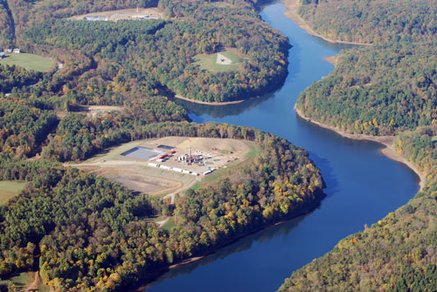
Land-use
Challenges
Land
Protected areas
Parks, forest
Farming
Drill sites
Pipelines
Lay-down yards
Source: Marcellus-shale.us
Notes:
The 1300 acre lake provides water to 150,000 people in northern Westmoreland County, Pennsylvania. Three horizontal wells are being drilled by CNX Energy in 2010 over the objections of some residents who are concerned about their water quality being affected

Slide 9
Vertical wells in Western PA – located every 300 meters
Notes:
Westmoreland County – 40 acre spaced vertical wells

Slide 10
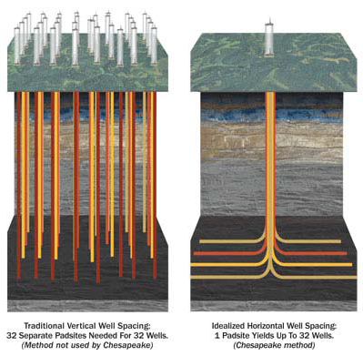
Land-Use: Vertical vs. Horizontal

Slide 11
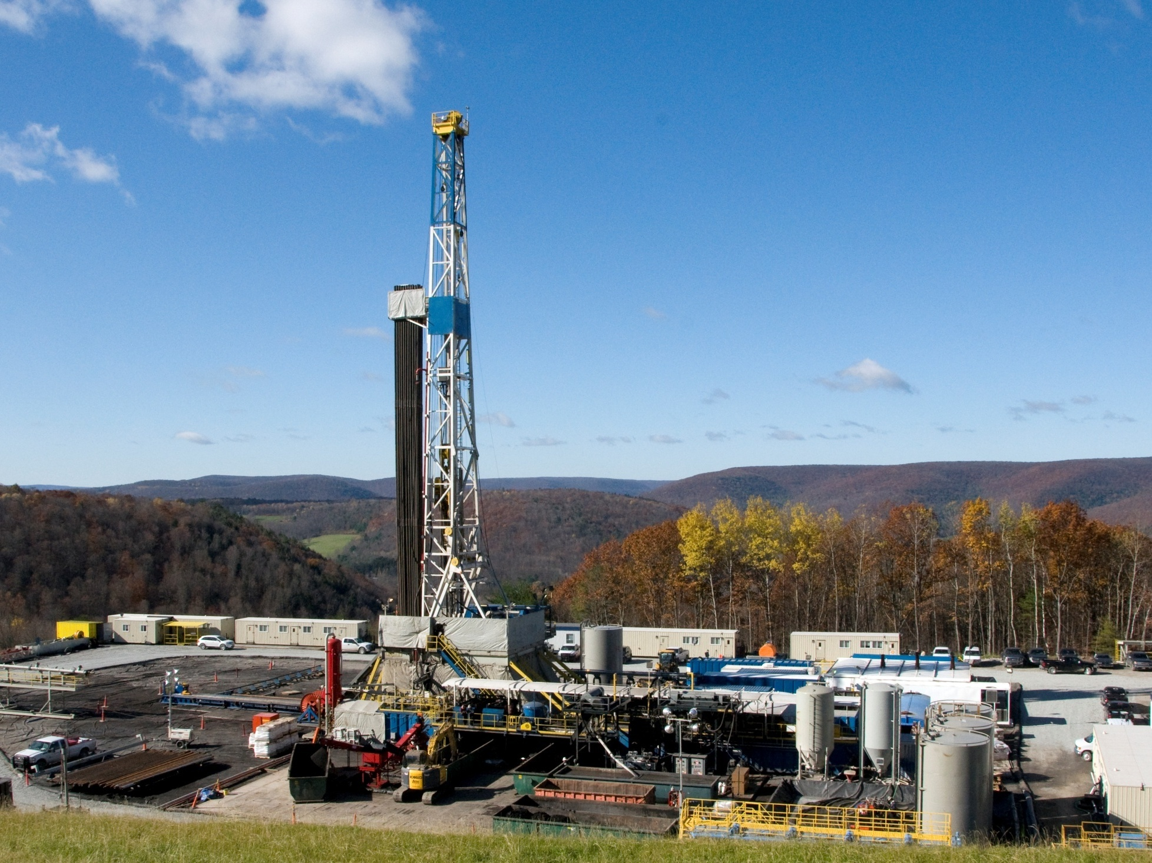
Jon Laughner
JBLaughner@psu.edu
Penn State Marcellus Center &
Marcellus Shale Education and Training Center
Thank you

