Slide 1
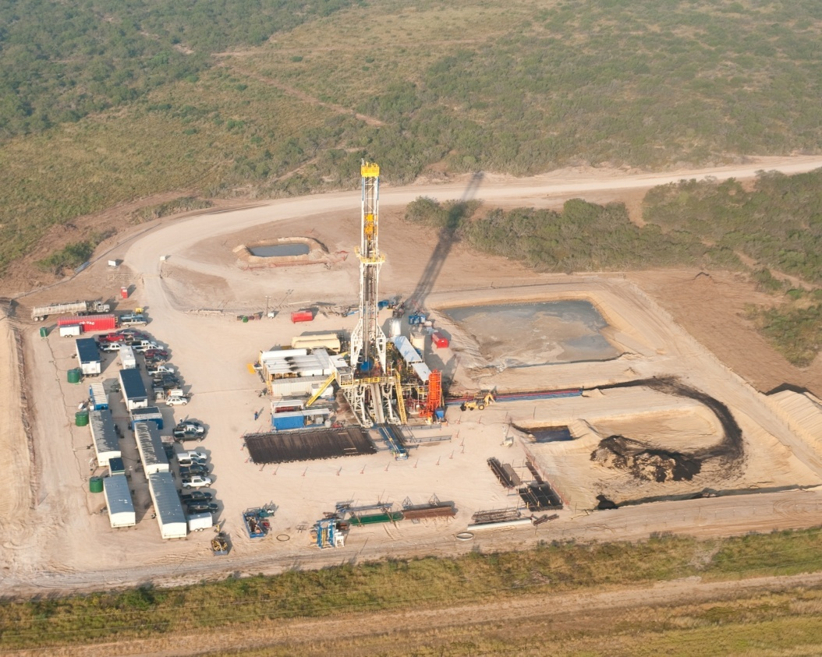
ANH Workshop – Social and Environmental Impact of E&P Operations
Drilling Presentation
Bogota, Colombia Dec 3rd 2012
Use this area for cover image (height 6.5cm, width 8cm)
Jose F. Mota
Well Engineering Manager for Onshore Americas

Slide 2
DEFINITIONS AND CAUTIONARY NOTE
Resources: Our use of the term “resources” in this presentation includes quantities of oil and gas not yet classified as SEC proved oil and gas reserves or SEC proven mining reserves. Resources are consistent with the Society of Petroleum engineers 2P and 2C definitions.
The companies in which Royal Dutch Shell plc directly and indirectly owns investments are separate entities. In this presentation “Shell”, “Shell group” and “Royal Dutch Shell” are sometimes used for convenience where references are made to Royal Dutch Shell plc and its subsidiaries in general. Likewise, the words “we”, “us” and “our” are also used to refer to subsidiaries in general or to those who work for them. These expressions are also used where no useful purpose is served by identifying the particular company or companies. ‘‘Subsidiaries’’, “Shell subsidiaries” and “Shell companies” as used in this presentation refer to companies in which Royal Dutch Shell either directly or indirectly has control, by having either a majority of the voting rights or the right to exercise a controlling influence. The companies in which Shell has significant influence but not control are referred to as “associated companies” or “associates” and companies in which Shell has joint control are referred to as “jointly controlled entities”. In this presentation, associates and jointly controlled entities are also referred to as “equity-accounted investments”. The term “Shell interest” is used for convenience to indicate the direct and/or indirect (for example, through our 23% shareholding in Woodside Petroleum Ltd.) ownership interest held by Shell in a venture, partnership or company, after exclusion of all third-party interest.
This presentation contains forward-looking statements concerning the financial condition, results of operations and businesses of Royal Dutch Shell. All statements other than statements of historical fact are, or may be deemed to be, forward-looking statements. Forward-looking statements are statements of future expectations that are based on management’s current expectations and assumptions and involve known and unknown risks and uncertainties that could cause actual results, performance or events to differ materially from those expressed or implied in these statements. Forward-looking statements include, among other things, statements concerning the potential exposure of Royal Dutch Shell to market risks and statements expressing management’s expectations, beliefs, estimates, forecasts, projections and assumptions. These forward-looking statements are identified by their use of terms and phrases such as ‘‘anticipate’’, ‘‘believe’’, ‘‘could’’, ‘‘estimate’’, ‘‘expect’’, ‘‘intend’’, ‘‘may’’, ‘‘plan’’, ‘‘objectives’’, ‘‘outlook’’, ‘‘probably’’, ‘‘project’’, ‘‘will’’, ‘‘seek’’, ‘‘target’’, ‘‘risks’’, ‘‘goals’’, ‘‘should’’ and similar terms and phrases. There are a number of factors that could affect the future operations of Royal Dutch Shell and could cause those results to differ materially from those expressed in the forward-looking statements included in this presentation, including (without limitation): (a) price fluctuations in crude oil and natural gas; (b) changes in demand for Shell’s products; (c) currency fluctuations; (d) drilling and production results; (e) reserves estimates; (f) loss of market share and industry competition; (g) environmental and physical risks; (h) risks associated with the identification of suitable potential acquisition properties and targets, and successful negotiation and completion of such transactions; (i) the risk of doing business in developing countries and countries subject to international sanctions; (j) legislative, fiscal and regulatory developments including potential litigation and regulatory measures as a result of climate changes; (k) economic and financial market conditions in various countries and regions; (l) political risks, including the risks of expropriation and renegotiation of the terms of contracts with governmental entities, delays or advancements in the approval of projects and delays in the reimbursement for shared costs; and (m) changes in trading conditions. All forward-looking statements contained in this presentation are expressly qualified in their entirety by the cautionary statements contained or referred to in this section. Readers should not place undue reliance on forward-looking statements. Additional factors that may affect future results are contained in Royal Dutch Shell’s 20-F for the year ended 31 December, 2011 (available at www.shell.com/investor and www.sec.gov ). These factors also should be considered by the reader. Each forward-looking statement speaks only as of the date of this presentation, 3 December, 2012. Neither Royal Dutch Shell nor any of its subsidiaries undertake any obligation to publicly update or revise any forward-looking statement as a result of new information, future events or other information. In light of these risks, results could differ materially from those stated, implied or inferred from the forward-looking statements contained in this presentation. There can be no assurance that dividend payments will match or exceed those set out in this presentation in the future, or that they will be made at all.
We use certain terms in this presentation, such as resources, that the United States Securities and Exchange Commission (SEC) guidelines strictly prohibit us from including in filings with the SEC. U.S. Investors are urged to consider closely the disclosure in our Form 20-F, File No 1-32575, available on the SEC website www.sec.gov. You can also obtain these forms from the SEC by calling 1-800-SEC-0330.

Slide 3
Agenda
Liquids-Rich Shales
E&P Phases
Drilling Technology
HSSE & Operating Principles
Pads & Directional Drilling
Well Integrity
Closing

Slide 4
1.0
LIQUIDS-RICH SHALES

Slide 5
ENERGY CHALLENGE & OUTLOOK
GLOBAL ENERGY DEMAND OUTLOOK
Mln Boe/d
Energy Challenge
We live in a world of ‘AND’: We need coal, oil, gas, nuclear, hydro, wind, solar, biofuels
Access to easy oil is over
Liquids-rich shales could play a key role
Industry outlook
Hydrocarbons dominate outlook
Growth required in all sectors of energy mix
Energy policy + sustained investment
OIL
BIOMASS
COAL
GAS
WIND
NUCLEAR
SHELL ACTIVITIES
SOLAR
OTHER RENEWABLES
SOURCE: SHELL ANALYSIS

Slide 6
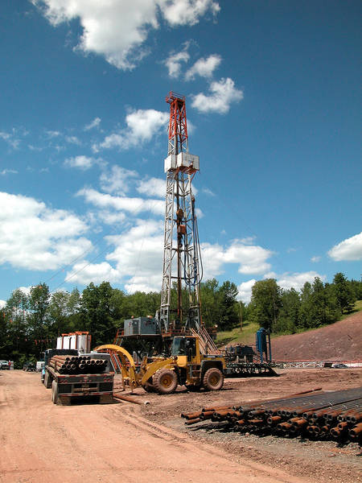
SHELL’S WORLD-WIDE TIGHT GAS + LIQUIDS-RICH SHALES PORTFOLIO
Canol
Groundbirch
Montney
Deep Basin
Germany
Alberta Bakken
Foothills
Niobrara
Pinedale
Utica
Ukraine
Monterey
Marcellus
Turkey
KEY SHELL POSITIONS
Mississippi Lime
China tight gas
Wolfcamp
Haynesville
Egypt
Tight Gas
Liquids potential
Eagle Ford
Oman
Colombia
Brazil
Neuquen
~50,000 km² (~12 million acres) acreage world wide
~12,000 km² (~3 million acres) liquids-rich shales added 2011; ~$2 billion, ~$825/acre

Slide 7
Onshore Portfolio Growth in the americas
Approximate Entry Dates:
1951 – Foothills, South Texas (exited 2010)
2002 – Pinedale
2004 – Deep Basin
2005 – Barnett (exited 2007)
2008 – Haynesville, Groundbirch/ Duvernay acquisition
2010 – Appalachia, Eagle Ford, Gundy, Niobrara, Del Bonita
2011 – Arrowhead, Fox Creek, Utica
2012 – Permian
Canol
Groundbirch
Montney
Deep Basin
Del Bonita
Foothills
Niobrara
Pinedale
Utica
Marcellus
Mississippi Lime
Permian
Haynesville
Eagle Ford
TIGHT GAS
LIQUIDS POTENTIAL
2011+
ENTRY

Slide 8
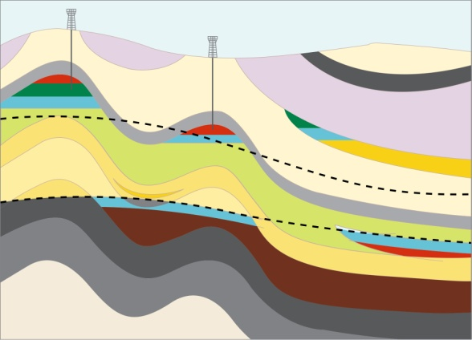
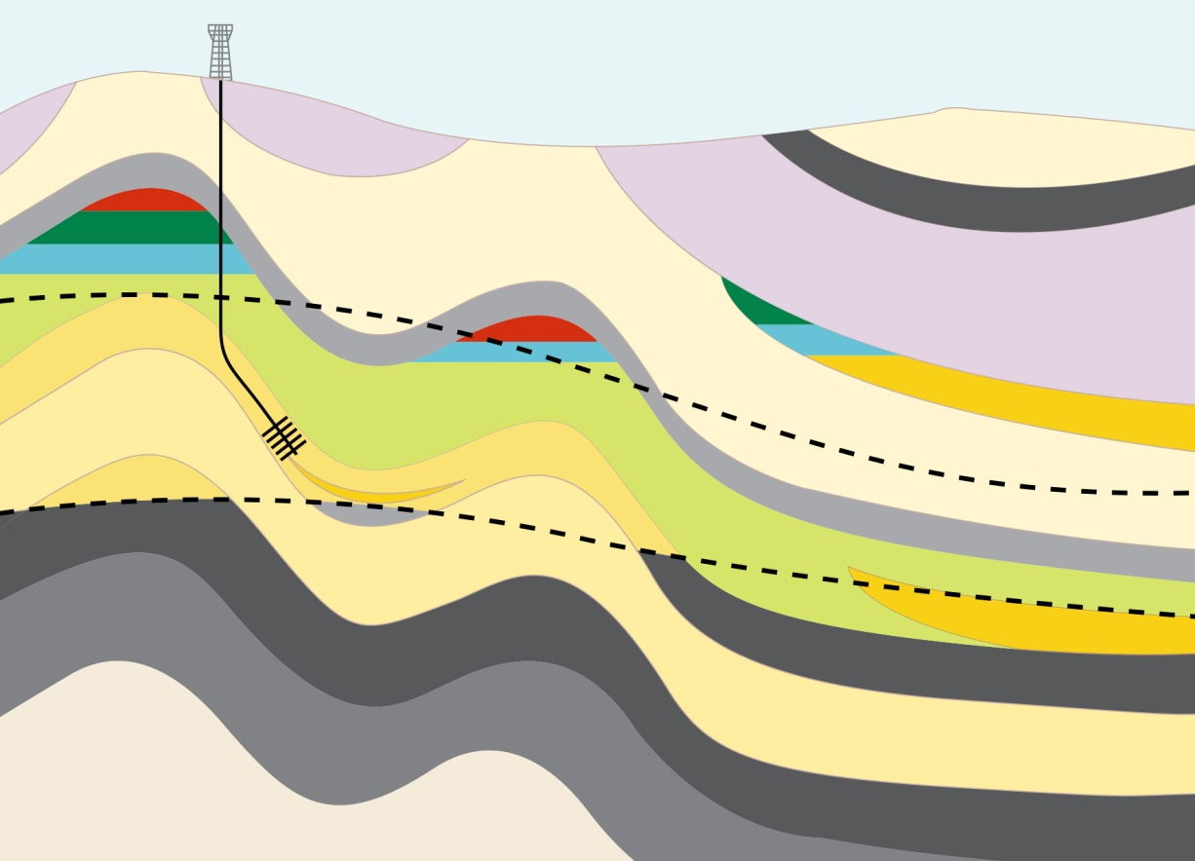
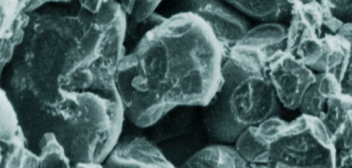
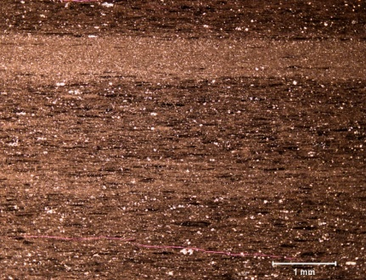
CONVENTIONAL oil and gas vs. TIGHT/shale GAS and liquids-rich shales
Conventional Oil & Gas
Liquids-Rich Shales
Stratigraphically Trapped Oil
Oil Window
Gas Window
Low Permeability
Oil Window
Liquids-Rich Potential
Gas Window
Shale Gas Potential
Permeable Sandstone
Shale
Tight Sandstone

Slide 9
A historical perspective on gas / lto shales
1821 First gas production from shales in Fredonia, NY
1858 Fredonia Gas Light Company established – First
Natural Gas Company in the US.
1926 Rise of gas production from Devonian
Shale (fractured shale play) in the Appalachian
Basin, by 1999 there are 21,000 wells.
1929 First true horizontal well
1940’s First Antrim shale wells drilled
1949 First commercial hydrofrac
1967 Project Gasbuggy was a single 29
kiloton nuclear device detonated to test it’s
potential for reservoir stimulation
1973 3rd and last nuclear stimulation test was
in western Colorado in Rio Blanco County
1970-1990 Rise of the Antrim Biogenic SG play as a
result of new completion techniques
1976 CBM exploration starts in Queensland Australia
1980 Recognition of limited reserves of conventional
gas remaining onshore US
1980 Introduction of Section 29 non-conventional
fuels tax credits
1981 First Mitchell Energy Barnett Shale test
1984 First gel frac in the Barnett Shale
1980’s Horizontal wells become more widely
available
1997 First Barnett shale slick water frac
1981 to 2000 566 Barnett Shale wells drilled by
2003 this risen to 2000.
2002 Mitchell Energy’s Barnett acreage acquired
by Devon
2003 Horizontal wells start to be drilled in the
Barnett Shale and multi-stage fracking
introduced
Source: WWW.WIKIPEDIA.ORG

Slide 10
2.0
E&P PHASES

Slide 11
Liquids-rich shale PROJECT: TYPICAL EVALUATION SCHEME
EXPLORATION
Few vertical wells; coring
Possible sidetracks; frac and test
Multiple horizontal wells across play area
Fracs and tests
Pilot development in sweetspot area (10’s of wells)
100-1000’s of wells
Technology is key enabler to commercial viability
Continuous explore and appraise to grow the initial development area
Prove up LRS play
Assess LRS mobility
APPRAISAL
Assess
produce-ability
Assess materiality
Assess lateral variability (sweetspots)
PILOT
Assess economic viability
DEVELOPMENT
Phased development, building out from initial development

Slide 12
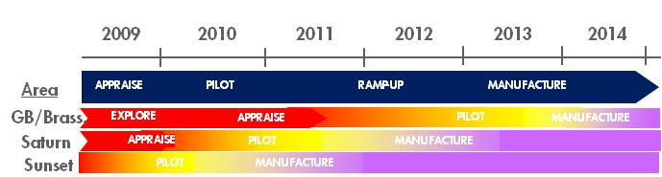
E&P PHASES ARE OFTEN COMPRESSED
Groundbirch Development Example
Multiple Regions, Multiple Phases
Changing How We Do Business
Traditional Exploration, Appraisal, Development compressed into one
Building a Factory Model
Manufacturing mind-set
Pooling, integrating resources
Production, Cost 

Slide 13
3.0
DRILLING TECHNOLOGY

Slide 14
SHELL UNCONVENTIONAL WELLS IN THE AMERICAS
Early Days
Single Wells
Vertical Wells
1-2 fracs / day
4 Stages / well
Sequential Activities
Today
Multi-well Pads
Horizontal Wells
4-6 fracs / day
15-25 Stages / well
Batch / Parallel activities
2012-2017 figures are not yet finalized
7 core assets consist of: Magnolia, Pinedale, Appalachia, Eagle Ford, Foothills, Groundbirch, Deep Basin.

Slide 15
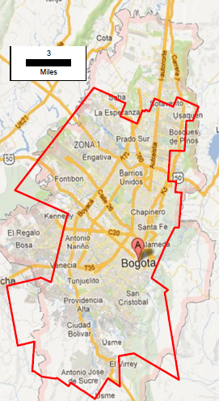
What’s different for Wells in unconventional plays?
Scale
Low recovery per well
More wells (100’s-1000’s) required than conventional reservoirs
Let’s discuss the implications on:
HSSE
Non-Technical Risk
Efficiency - “well manufacturing”
Technology
Performance (EUR and Cost)
Bogota
“P-Ranch” Area of Operations

Slide 16
3.1
DRILLING – HSSE & OPERATING PRINCIPLES

Slide 17

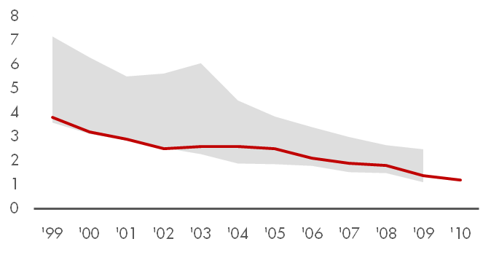

HSSE: SHELL’S PRIORITY
SHELL SAFETY PERFORMANCE
Injuries – TRCF
GOAL ZERO
COMPLY
INTERVENE
Shell
IOC Range
Focus on personal and process safety
Industry leader in Sustainable Development
RESPECT

Slide 18
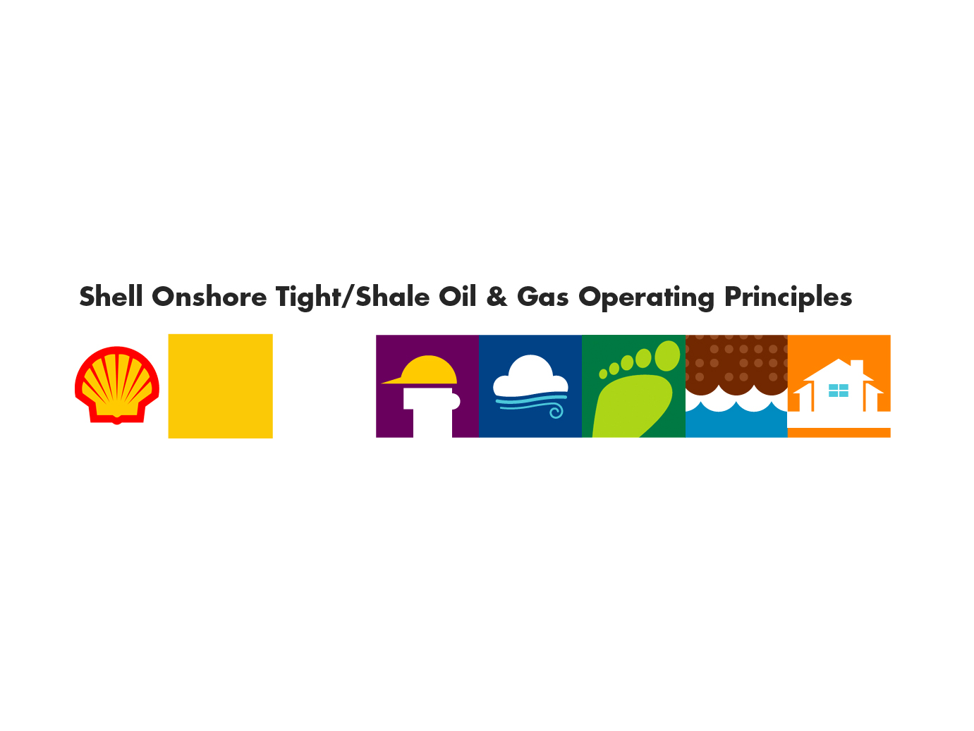
SHELL ONSHORE TIGHT SAND/SHALE OIL & GAS OPERATING PRINCIPLES
Safety & Well Integrity
Shell designs, constructs and operates wells and facilities in a safe and responsible way.
Footprint
Shell works to reduce its operational footprint.
Water
Shell conducts its operations in a manner that protects groundwater and reduces potable water use as reasonably practicable.
Community
Shell engages with local communities regarding socio-economic impacts that may arise from its operations.
Air
Shell conducts its operations in a manner that protects air quality and controls fugitive emissions.

Slide 19
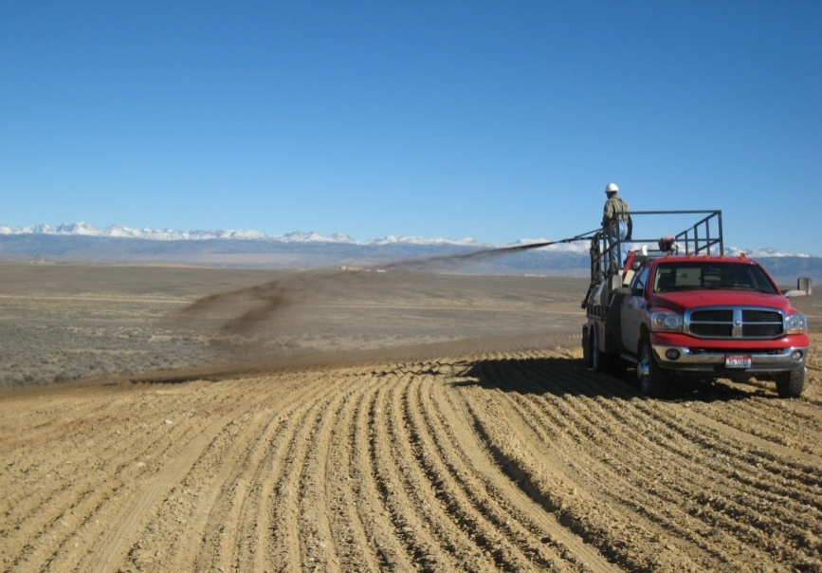
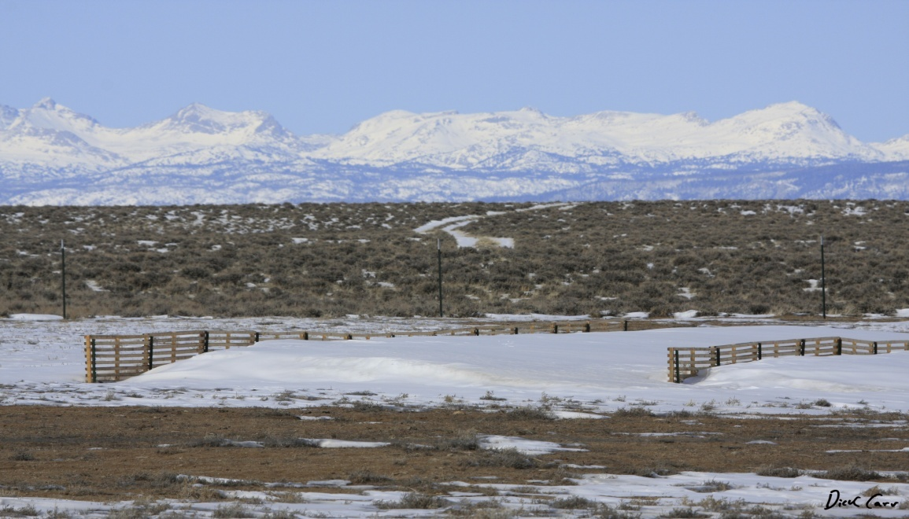
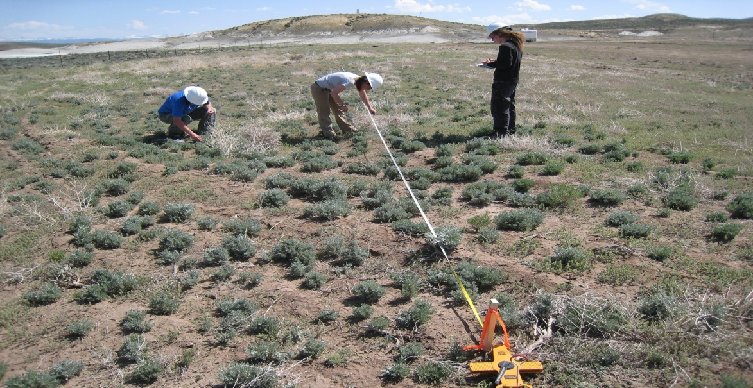
Site decommissioning
Objective is to restore area to its original condition
Copyright of Shell South Africa Upstream B.V.

Slide 20
3.2
DRILLING: PADS & DIRECTIONAL DRILLING

Slide 21
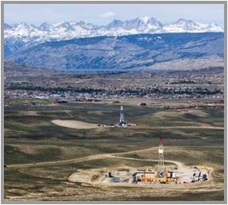
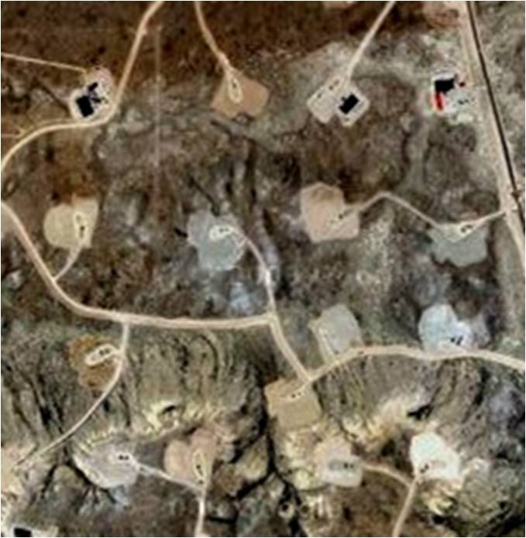
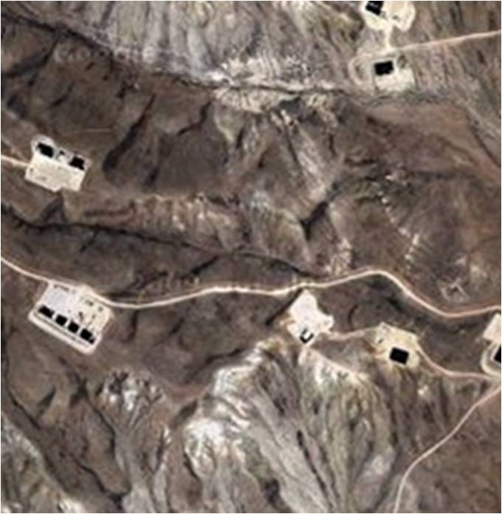
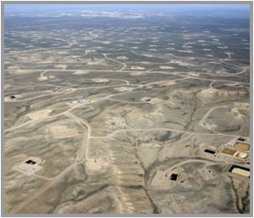
Problem: How do you minimize surface footprint?
PINEDALE: SHELL OPERATED
JONAH: NON-OPERATED
Up to 4 pads each pad having up to 32 wells
Up to 64 pads with each pad having a single well
SQUARE MILE OVERVIEW
SQUARE MILE OVERVIEW
Adjacent gas fields, different development impacts
Shell setting new standards for surface footprint reduction

Slide 22
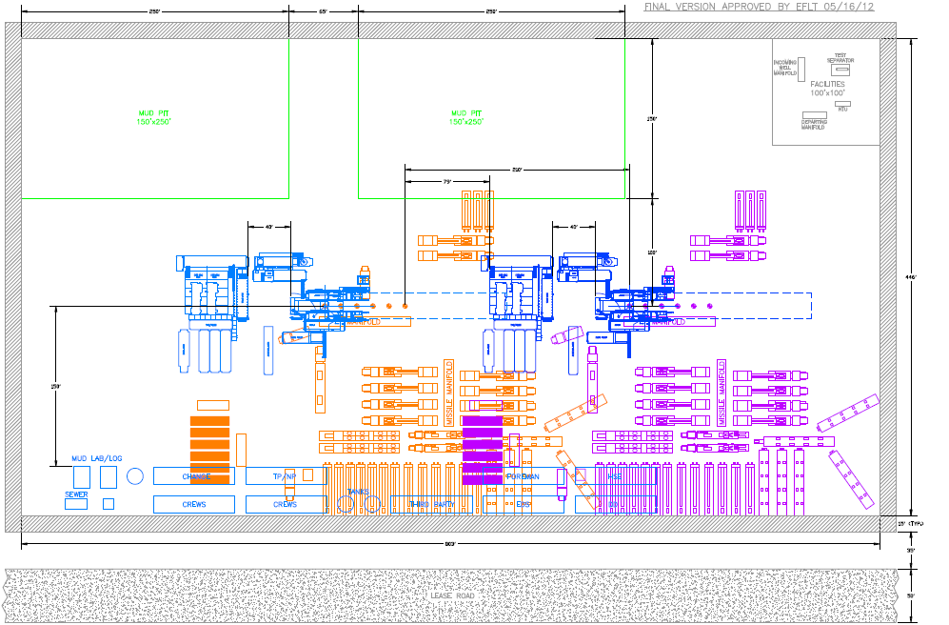
Pad Layout
800 ft x 450 ft
Large Pad for Onshore:
Size of frac spread may dictate overall footprint
# of cluster of wells dictate if SIMOPS is feasible

Slide 23
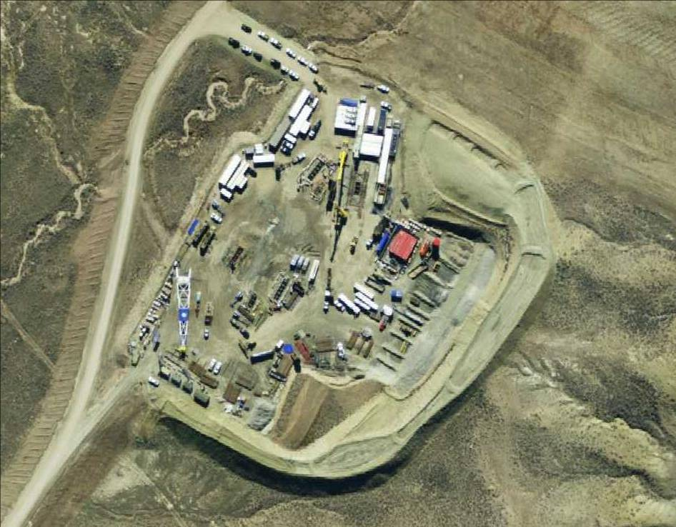
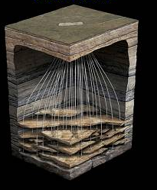
Minimising Environmental Footprint
Active Hydraulic Frac Program
4 Active Producing Wells
11 Active Producing Wells
8 Active Producing Wells
Rigging Up a Drill Rig
Active Production Facilities
SIMOPS at Shell’s Pinedale Warbonnet 13-10 PAD

Slide 24
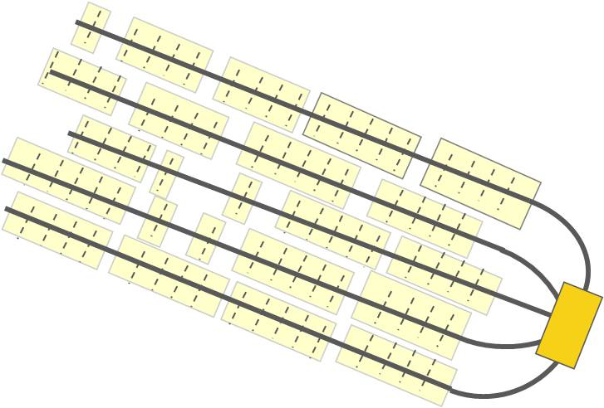
PADS ARE NOT ALL EQUAL
 | CANADA | TEXAS | PENNSYLVANIA | WYOMING*
Typical Pad Size | 520’ x 575’ to 730’ x 670’ | 450’ x 800’ | 350’ x 500’ | 400’ x 800’ and larger
No. of Clusters | 1, 2 or 4 | 1 | 1 | 2 – 6
No. of Wells/Cluster | 3, 6, or 13 | 4 | 6 -12 | 6 - 8
Well Spacing at surface (ft) | 12 | 15 | 15 | 6
Sub-surface Spacing (ft) | 300 – 500 | 800 | 1,000 | Not Hz wells
Different Pad Options, well count and spacing to account for different size fracs, well spacing requirements and optimum Development Costs.
* WY = Multiple stacked reservoirs in a tight sand

Slide 25
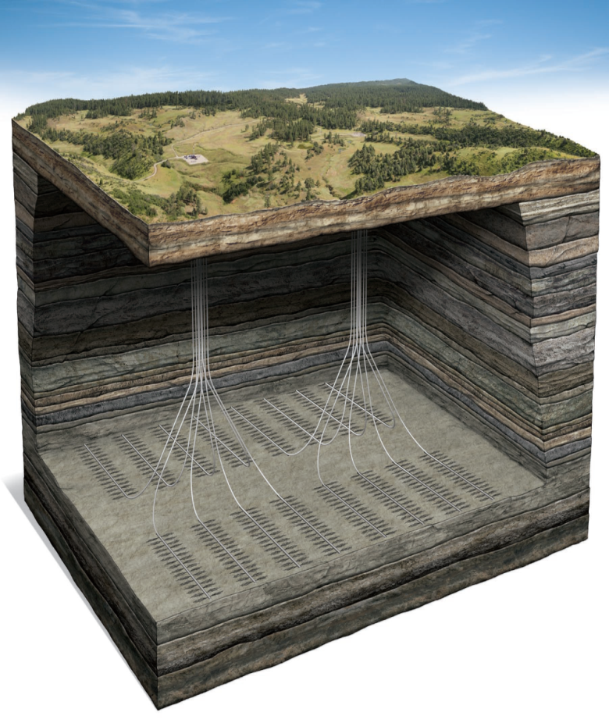
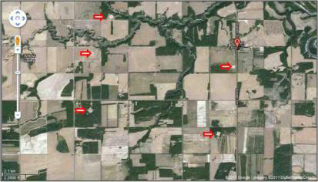
overall footprint
Groundbirch Example
As many as 32 wells can originate from the same surface location
Directional Drilling from pad enables footprint reduction
Red Arrows indicate surface locations

Slide 26
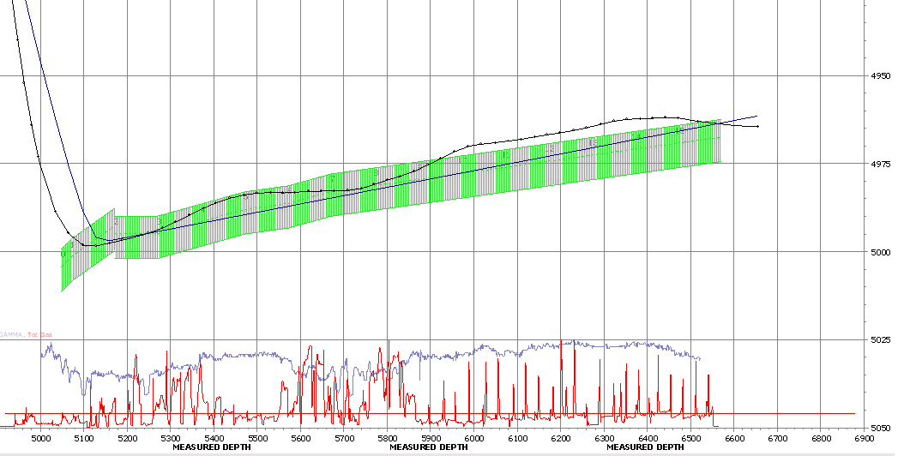
GEOSTEERING
Pilot Holes provide the key Gamma Ray signature for geosteering.
Heterogeneity in the field can lead to drilling horizontals outside of pay
Real Time Operating Centers can be used to centralize know-how

Slide 27
3.3
DRILLING: WELL INTEGRITY

Slide 28
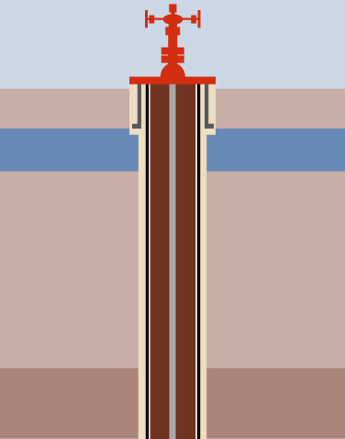
WELL INTEGRITY & ISOLATION
Surface casing is set below the groundwater level and is cemented to surface.
Surface Casing is designed to:
Protect groundwater
Maintain well integrity in the event of a “kick”
Cement is designed to:
Prevent gas migration and stray gas.
Provide structural support to the pipe
Prior to drilling out the surface casing, a pressure test is conducted.
If Intermediate Casing is Required:
May be needed for hole stability, well integrity (kick tolerance) or back up for frac
Prior to drilling out, casing is pressure tested.
Production Casing
Designed to withstand multiple frac load cycles
It typically serves as primary production conduit
Wells are monitored with pressure sensors throughout the life of the well
WELLHEAD
Cement
SOIL
Conductor Pipe
Set across surface soils and shallow rocks
AQUIFER
Cement
Surface Casing
Cemented at appropriate depth to protect shallow fresh water aquifers
Production Casing
Designed to withstand multiple frac load cycles

Slide 29
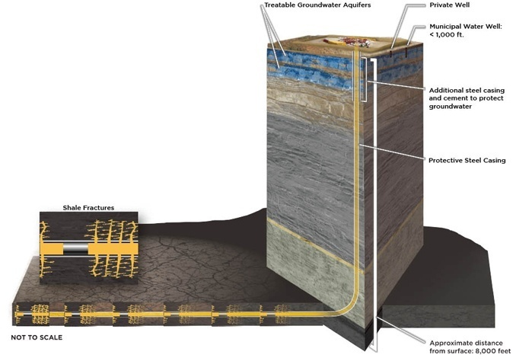
DRILLING AND COMPLETIONS OVERVIEW
Treatable Surface Aquifers
Private Well
Municipal Water
Additional Steel Casing and Cement to protect groundwater
Protective Steel Casing and Cement
Shale Fractures
Horizontal leg up to 9,000’
Fracs occur thousand of feet
below the groundwater

Slide 30
4.0
TECHNOLOGY

Slide 31
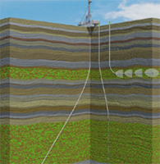
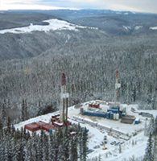
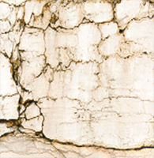
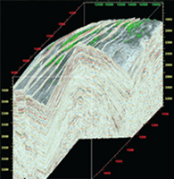
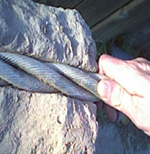
Technology & Integration
Technology Enablers
Decrease Well Costs
Best in class drilling technologies
Drilling Automation & Well Manufacturing
Rigs on skids
Mud composition
Fracturing techniques
Multi-stage completions
Micro seismic
Increase Production
Integration of techniques
Selecting the best areas
Fracture prediction
Rock property analysis
Seismic evaluation
Geomechanical analysis
Geochemical analysis
Reduce Footprint
Green Completions
Multi well pads
Light, noise inhibitors
Fluids recycle as reasonably practicable
Pipeline water as reasonably practicable
Novel stimulation technologies
Proprietary
Technology
3rd Party
Products
Integration
Shell
Capabilities
WELL DESIGN
PAD DRILLING
FRACTURE PREDICTION
SEISMIC EVALUATION
NOVEL TECHNOLOGIES

Slide 32
UNDERBALANCED DRILLING
Tight Rock may provide opportunities to drill wells differently
E.g. Underbalanced Drilling in Haynesville
E.g. Underbalanced Tripping Operations in Eagle Ford

Slide 33
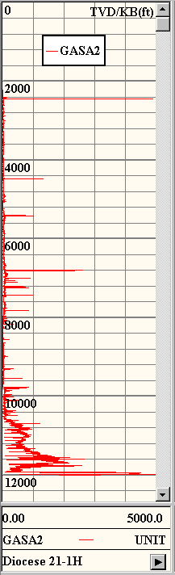
Well control example 1/2
Early on:
Tried to address with high MW.
Common to have losses
Multiple days to recover from a kick
Kicks- MW @ 16.5 ppg

Slide 34
Well control example 2/2
Tested to address Well Control Challenges more efficiently and effectively
From Complex to Simple
Tested proven technology from South Texas and GOM
Brought in know how from Pinedale
Develop own procedures and capabilities
Use casing pressure to detect influx < 1 min. Follow shut-in procedure
Kick

Slide 35
5.0
IN CLOSING

Slide 36
Liquid-Rich Shales – In Closing
Safety & Well Integrity
Wells can be designed and executed in a safe an responsible manner
Thousands of Wells in Unconventional plays have already been delivered safely
Water
Groundwater can be protected
Water Resources Management needs early consideration
Air
It is possible to mitigate impact to air quality
Footprint
Multi-well pad can minimize footprint impact
Community
Early engagement is key for the long term success of any project

