Slide 1
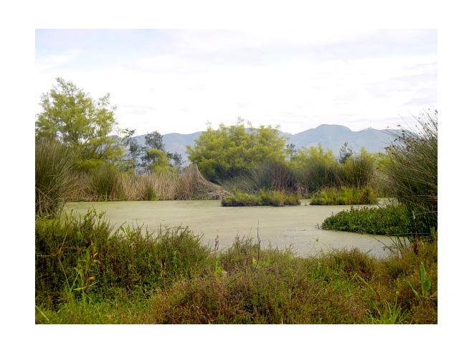

Ecosystem Services Provided by Wetlands
The world’s leading sustainability consultancy

Slide 2
What are Ecosystem Services?
Ecosystem services are benefits that ecosystems provide to people. They can be classified into four categories:
Provisioning - goods or products obtained from ecosystems such as food, timber, fiber, and freshwater.
Regulating - benefits obtained from an ecosys­tem’s control of natural processes, such as climate regulation, disease control, erosion prevention, water flow regulation, and protection from natural hazards.
Cultural - nonmaterial benefits such as recreation, spiritual values, and aesthetic enjoyment.
Supporting services are the natural processes, such as nutrient cycling and primary production, which maintain the other services.

Slide 3
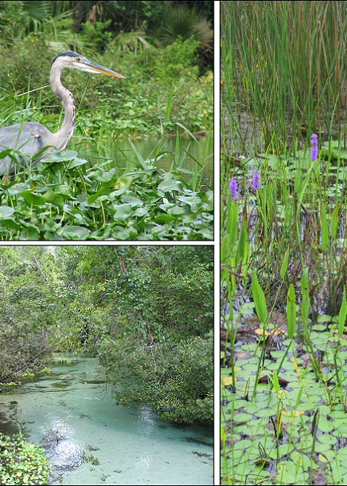
Ecosystem Services Provided by Wetlands
  Wetlands are among the most productive ecosystems in the world.
    Similar to rain forests and coral reefs.
    Source of substantial biodiversity.
  Wetlands have been described both as “the kidneys of the landscape”, because of the filtration functions
  Known as the “biological supermarkets” because of the extensive food webs and rich biodiversity they support.

Slide 4
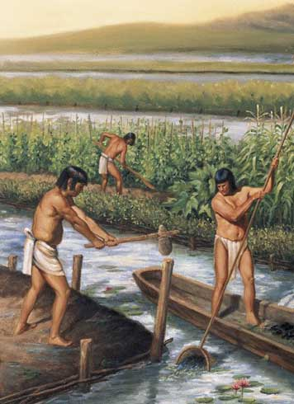
Ecosystem Services Provided by Wetlands
Wetlands - the birth of modern civilization.
  Wetland regions gave rise to farming, critical to the development and survival of early human civilizations.
    Mesopotamians, Mayans (as early as 6,000 years ago)
  Modern civilizations depend on properly functioning ecosystems and the services provided by wetlands.
Notes:
Ramsar - http://www.ramsar.org/pdf/info/services_00_e.pdf
Mayans converted wetlands to farmland
http://www.nature.com/news/2010/101105/full/news.2010.587.html
Image
http://3.bp.blogspot.com/_QgTIbFilNZc/S_x3gJlIaMI/AAAAAAAABBQ/ImkG9yGm6VU/s1600/maya_agri.jpg
http://i-akumal.blogspot.com/2010/05/ancient-mayan-farming-and-irrigation.html

Slide 5
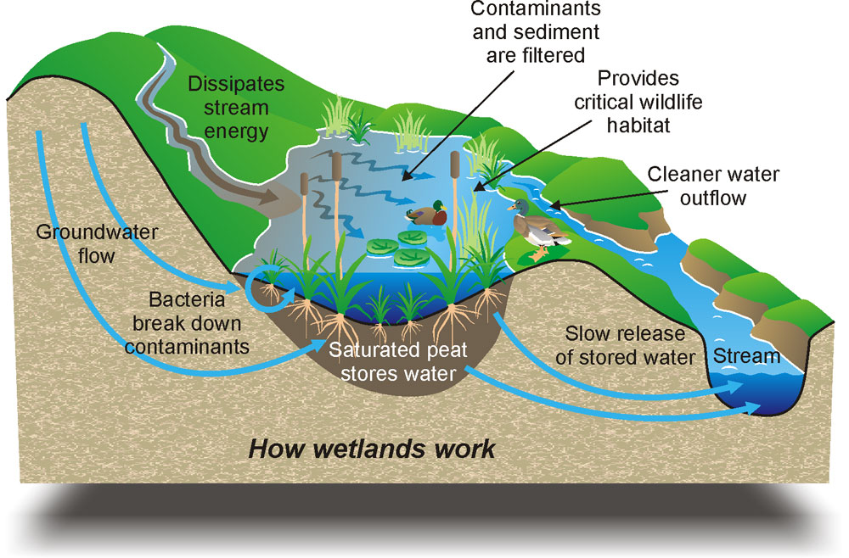
Ecosystem Services Provided by Wetlands
Wetland services include:
  Flood control
  Groundwater replenishment
  Shoreline & storm protection
  Sediment & nutrient retention and export
  Water purification
  Reservoirs of biodiversity
  Wetland products
  Cultural values
  Recreation & tourism
  Climate change mitigation and adaptation
Notes:
Map of the US -
http://www.internationalteflacademy.com/Portals/67369/images/North-America-TEFL-Classes.jpg
Reference – $ 14.9 trilion -
Costanza R, d.Arge R, de Groot R, Farber S, Grasso M, Hannon B, Limburg K, Naeem S, O.Neill RV, Paruelo J, Raskin RG, Sutton P & van den Belt M 1997. The value of the world.s ecosystem services and natural capital. Nature 387, 253.260.
10 ecosystem services of wetlands
Ramsar - http://www.ramsar.org/pdf/info/services_00_e.pdf

Slide 6
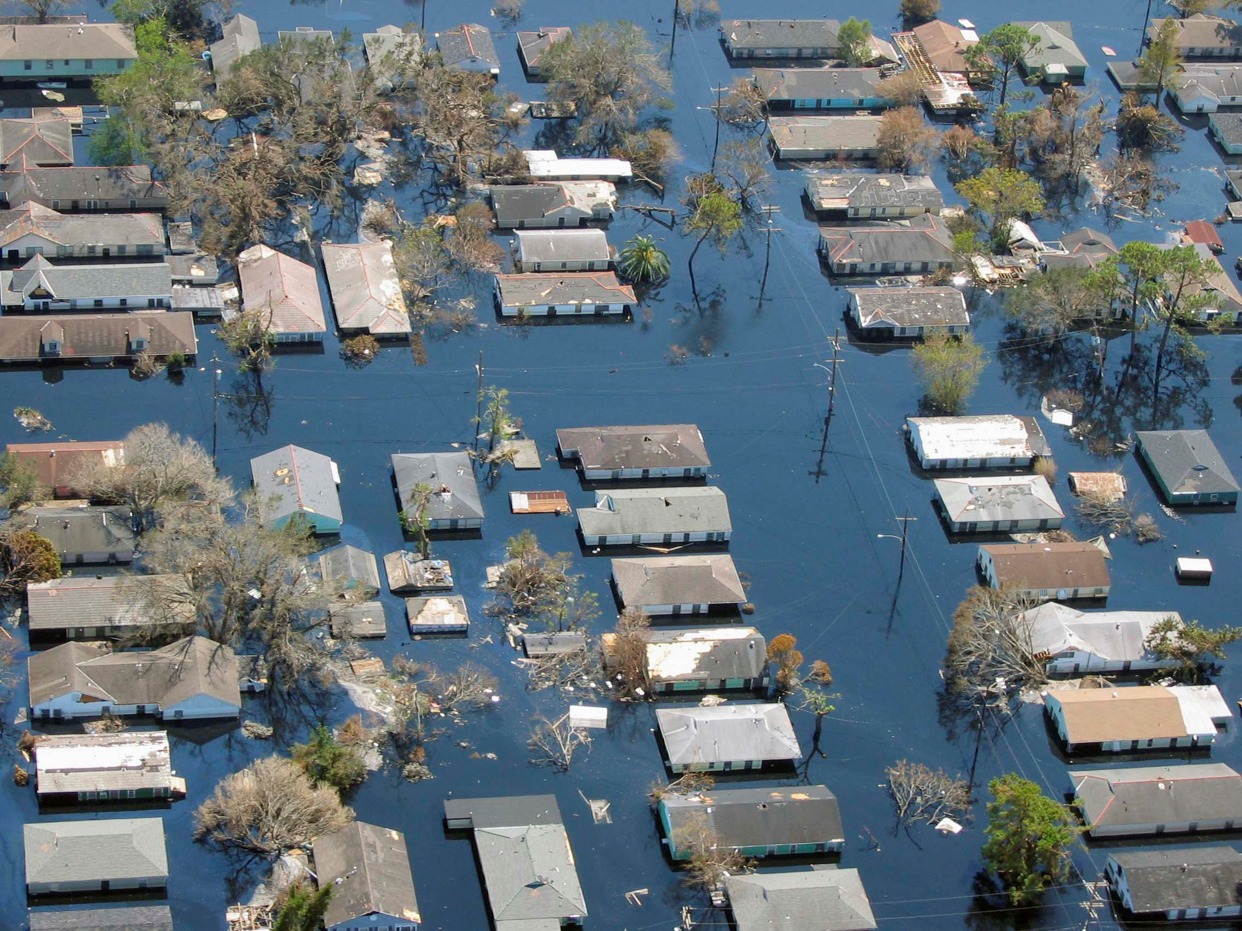
Ecosystem Services Provided by Wetlands
Flood control:
  From 1990-2000 floods killed about 100,000 people and affected over 1.4 billion people worldwide.
  Indirectly floods can cause the loss of economic and agricultural production and a decrease of socio-economic welfare.
  Wetlands regulate water flow following storms.
Notes:
Flood pic – Katrina
http://passionatereads.files.wordpress.com/2011/07/katrina-new-orleans-flooding4-2005.jpg
Graph:
http://water.epa.gov/type/wetlands/upload/flooding.pdf
Reference:
JONKMAN 2005 - Global Perspectives on Loss of Human Life
Caused by Floods - http://www.citg.tudelft.nl/fileadmin/Faculteit/CiTG/Over_de_faculteit/Afdelingen/Afdeling_Waterbouwkunde/sectie_waterbouwkunde/people/personal/jonkman/doc/jonkman_NH_globalpers.pdf

Slide 7
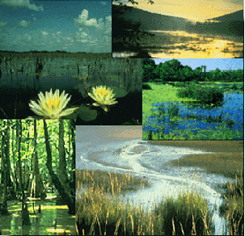
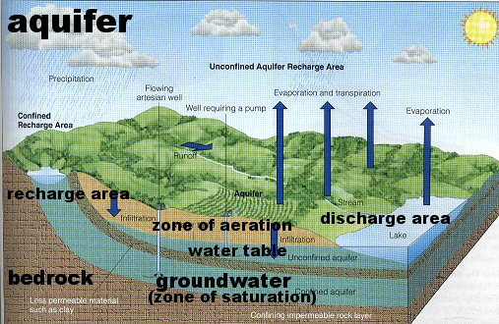
Ecosystem Services Provided by Wetlands
Groundwater replenishment:
  There are various kinds of wetlands.
    Coastal marsh
    Tropical forest
    Mangrove
    Grasslands
  Wetlands that occur on permeable sediments overlying aquifers percolate water into the aquifer below, playing a vital role in keeping it ‘recharged’.
Notes:
Various kinds of wetlands – EPA site
http://water.epa.gov/type/wetlands/types_index.cfm
Reference:
Ramsar - http://www.ramsar.org/pdf/info/services_00_e.pdf

Slide 8
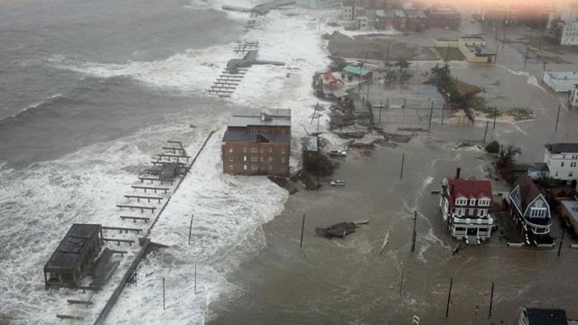
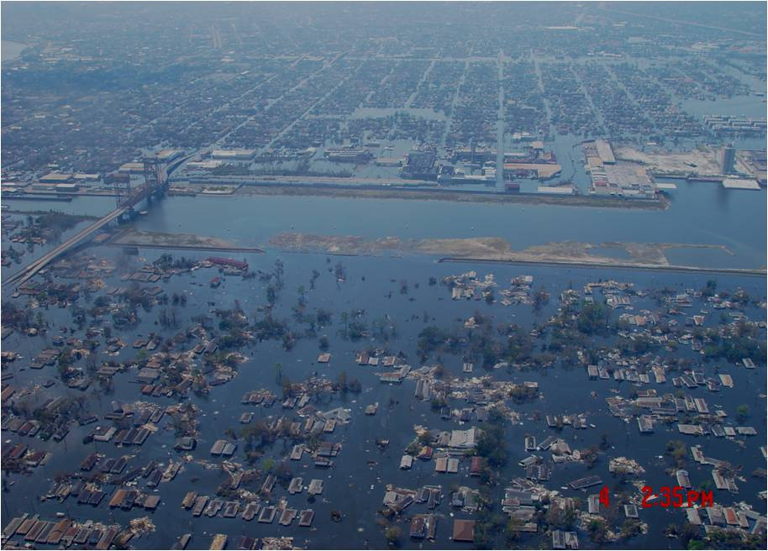
Ecosystem Services Provided by Wetlands
Shoreline & storm protection:
  In the U.S. the estimated value of coastal wetlands in reducing the severity of impacts from hurricanes is $23.2 billion per year.
  The conversion or loss of one hectare of coastal wetland is estimated to be equal to a loss of ecosystem services worth $33,000 per year, on average.
  Each 13 km of marsh reduces the storm surge by 1 m.
  Damage from Hurricane Sandy could reach $50 billion. Second most expensive in the USA.
Atlantic City, New Jersey following Hurricane Sandy. Image courtesy of NASA: science.nasa.gov
City of New Orleans following Hurricane Katrina. Image courtesy of NASA: science.nasa.gov
Notes:
Storm pic top – Sandy
http://a.abcnews.com/images/ABC_Univision/121029_sandy_storm_surge_wg.jpg
Youtube video
http://www.youtube.com/watch?NR=1&v=MXtkINUddfs&feature=endscreen
Reference:
Ramsar - http://www.ramsar.org/pdf/info/services_00_e.pdf

Slide 9
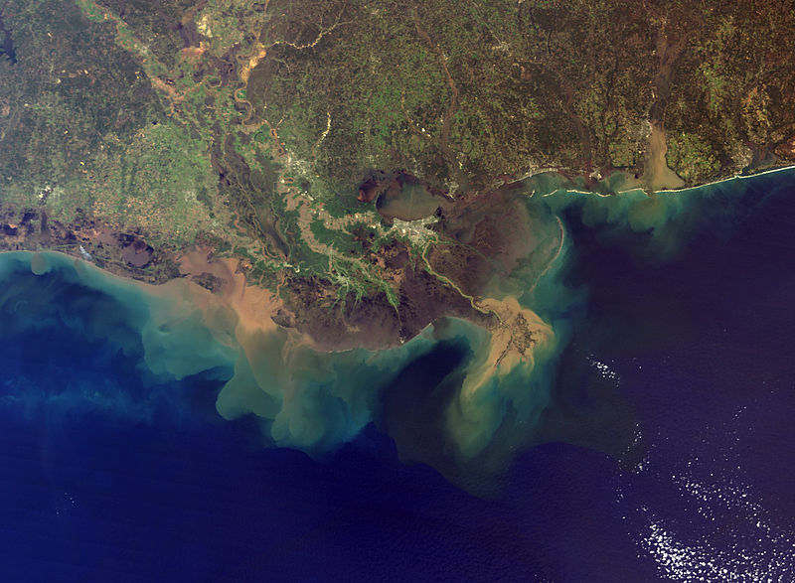
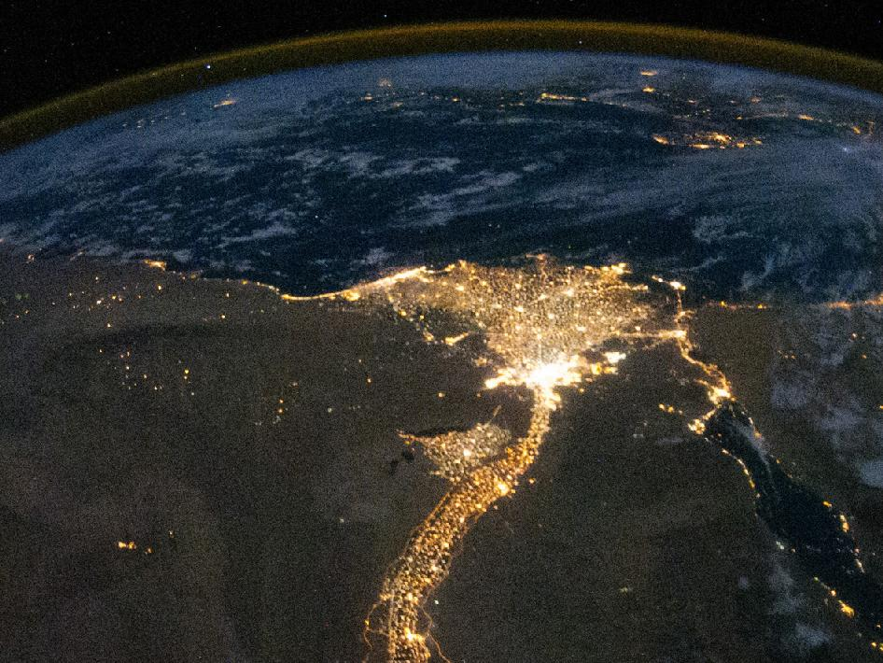
Ecosystem Services Provided by Wetlands
Sediment & nutrient retention and export:
  When rivers reach wetlands, such as floodplain lakes and marshes, the speed of water flow suddenly slows and sediments are deposited
  Two examples of productive wetland regions - Mississippi River Delta and the Nile River Delta (sediment plumes are visible)
Notes:
Mississippi river delta ; http://en.wikipedia.org/wiki/Mississippi_River_Delta
Nile delta: http://earthobservatory.nasa.gov/IOTD/view.php?id=46820
Reference:
Ramsar - http://www.ramsar.org/pdf/info/services_04_e.pdf

Slide 10
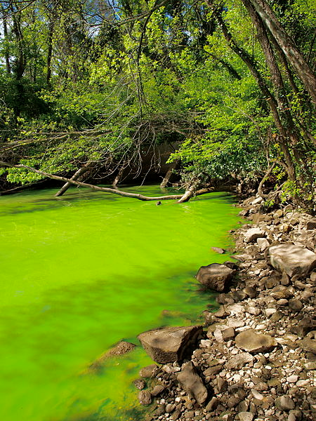
Ecosystem Services Provided by Wetlands
Water purification:
  Sediments and excess nutrients (i.e., phosphorous and nitrogen) and heavy metals are trapped in wetlands.
Algae bloom in the Potomac River
Notes:
Reference:
Ramsar - http://www.ramsar.org/pdf/info/services_05_e.pdf
Wetlands play an important role in purifying water by ‘locking up’ pollutants in their sediments, soils and vegetation. In particular, high levels of nutrients such as phosphorous and nitrogen, commonly associated with agricultural runoff and sewage effluent, can be significantly reduced by wetlands. This may prevent those same nutrients from reaching toxic levels in groundwater used for drinking purposes. It also helps to reduce the risk of eutrophication
in surface-water bodies further downstream, a process that occurs when high nutrient levels cause a massive boost in algal growth, depleting oxygen and blocking out the light that other aquatic plants and animals need to survive.

Slide 11
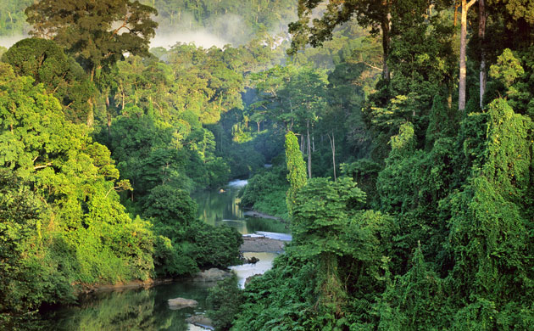
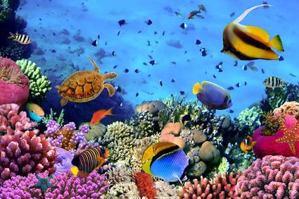
Ecosystem Services Provided by Wetlands
Reservoirs of biodiversity:
  Over 100,000 species have been identified in freshwater wetlands alone.
    More than 50,000 of these are insects and 20,000 are vertebrates.
    New species are still being discovered for example around 200 species of freshwater fish a year.
    High number of species that live only in wetlands.
© vlad61_61 / Fotolia
Notes:
Reference:
Ramsar - http://www.ramsar.org/pdf/info/services_06_e.pdf

Slide 12
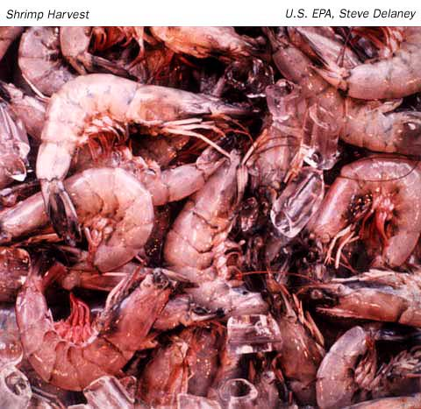
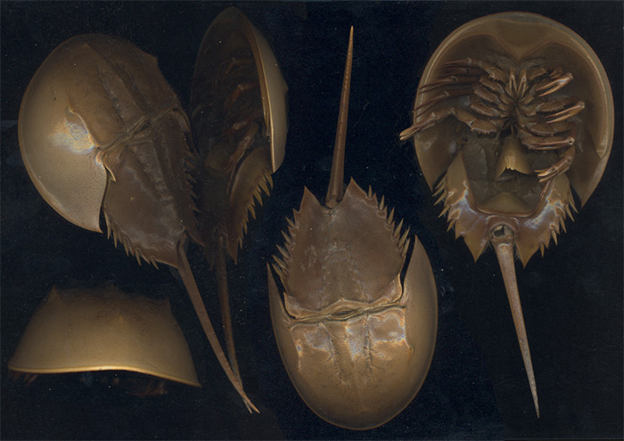
Ecosystem Services Provided by Wetlands
Wetland products:
  Fish and shellfish
    Wetlands provide breeding and nursery habitat for fish and shellfish
  Medical products
    The medical profession uses an extract from the horseshoe crab's blood to test the purity of medicines
    the horseshoe crab's shell has been used to speed blood clotting.
Notes:
Horseshoe crab video – PBS/Nature
http://www.youtube.com/watch?v=e8KlAmtIu1E
Reference:
Ramsar - information packs http://bit.ly/QUmP6E

Slide 13
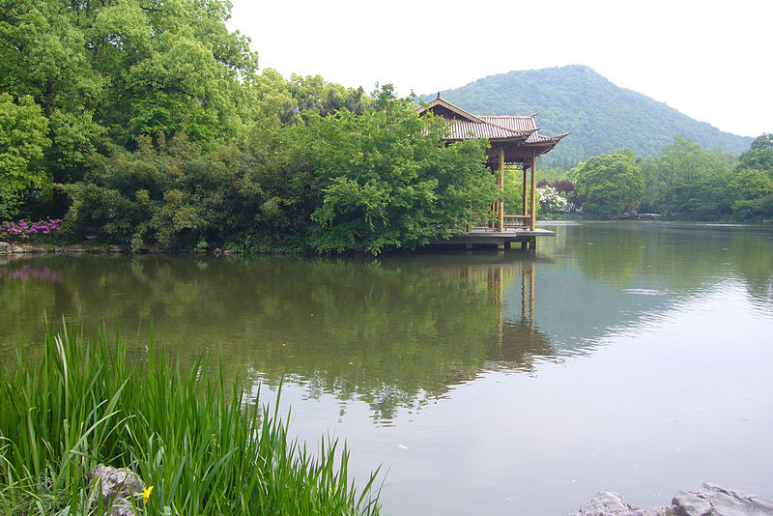
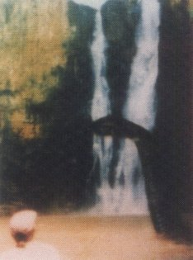
Ecosystem Services Provided by Wetlands
Cultural values:
  Wetlands have historically been part of the cultural history of early civilizations, playing a defining role in mythology, art and religion.
  Xixi Wetland Park in China:
    First and only national wetland park in China.
    1,800 years of history and an abundant cultural heritage.
      Traditional Dragon Boat Contest
      Silkworm feeding and silk production
  Inkanyamba:
    A serpent rumored to live near a waterfall lake in South Africa
Xixi Wetland Park, China
Notes:
XiXi pic:
http://en.wikipedia.org/wiki/Xixi_National_Wetland_Park
Inkanyamba pic:
http://forteanzoology.blogspot.com/2009/04/richard-freeman-howick-falls-monster.html
Reference:
Ramsar - http://www.ramsar.org/pdf/info/services_08_e.pdf

Slide 14
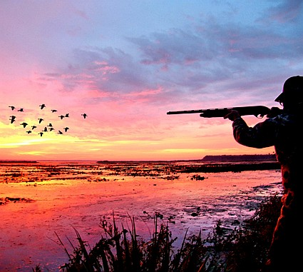
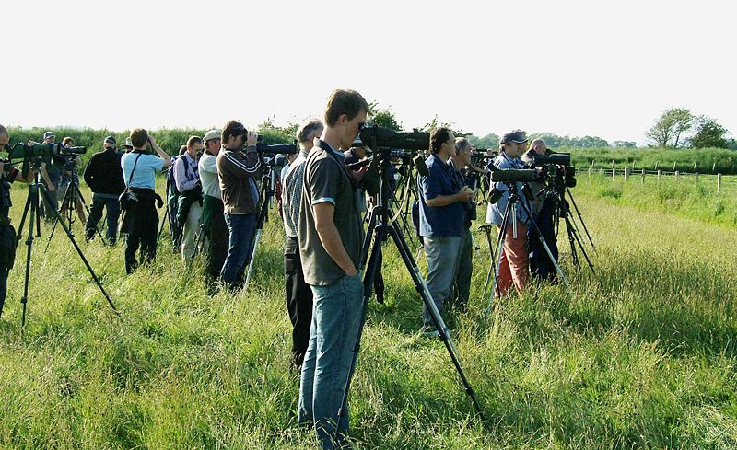
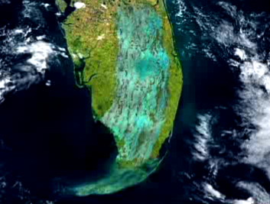
Ecosystem Services Provided by Wetlands
  Recreation & tourism:
  Hunting - Since 1934, sales of Federal Duck Stamps Total $750 million and have bought 6 million acres of wetlands in the U.S.A..
  Birding - More than 71 million people fed, photographed and observed wildlife in 2006 and spent nearly $45 billion on their activities
  Ecotourism – Florida Everglades in 2008: 822,118 visitors spent $119 million.
Notes:
Duck hunting pic http://www.floridasportsman.com/2012/05/25/features_0812_florida_duck_hunting/
- Pic of southern Florida as it was with intact water flows prior to development
References:
Ramsar – http://www.ramsar.org/pdf/info/services_09_e.pdf
Birding - http://www.fws.gov/duckstamps/Info/Stamps/stampinfo.htm

Slide 15
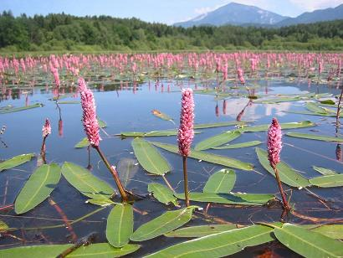
Ecosystem Services Provided by Wetlands
More resources
  Wetland Ecosystem Services – an introduction. http://www.ramsar.org
  Ramsar - information packs http://bit.ly/QUmP6E
Thank you!

