Slide 1
Best Practices and Best Available Technology for Prevention and Mitigation of Impacts of Hydrocarbons Within Wetlands
Paul R. Krause, Ph.D.
Knowledge Management Program
Sensitive Ecosystem Workshop Bogota, Colombia November 2012

Slide 2
Best Practices and Technologies
There are three important aspects of a successful oil and gas exploration program in and near wetlands
Prevention – To prevent habitat degradation it is vital to understand the type and level of impact form activities
Mitigation – Not all impacts can be avoided, but good mitigation practices will lessen the net impact of activities
Monitoring – Development of a strong monitoring program both before and after development activities will provide solid evidence and documentation of impact

Slide 3
Prevention
The world’s leading sustainability consultancy

Slide 4
Prevention Practices – Impact Analysis
The key to successful prevention is a good understanding of the expected project impacts. This is accomplished through Impact Analysis
Environmental, Social, and Health Impact Assessment (ESHIA)
Global standard practice for large capital projects such as O&G exploration and production projects.
Addresses impacts from the project on:
Environmental – ecology, biodiversity, ecosystem services
Social –human populations, economy, project integrations
Health –human health
Environmental Impact Assessment (EIA)
US National Standard under the National Environmental Policy Act (NEPA)
US State-wide regulations
California Environmental Quality Act (CEQA)

Slide 5
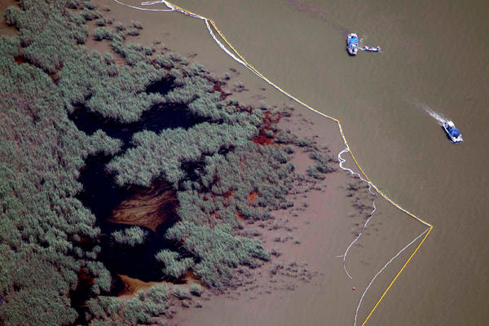
Prevention Practices – Plans
Another key aspect is the development of comprehensive plans for projects
Spill Planning
Development of a National Response System
US Coast Guard is lead agency in the US
Development Regional Response Plans
Mapping of Resources at Risk (RAR)
Sensitive ecological areas
Important economic areas
Tactical Response Plans (TRP)
Boom placement
Equipment locations
Project-specific Plans
Modelling of spill scenarios for all projects

Slide 6
Prevention Practices – Plans
Project-Specific Plans
Spill Response Plan
Modelling of spill scenarios
Implementation of TAP
Land Use Plan
Erosion control
Effective road and infrastructure path citing
Designated project avoidance areas
Water Use Plan
Project water needs
Population water needs
Changes to natural water pattern
Waste water handling
Health and Safety Plans

Slide 7
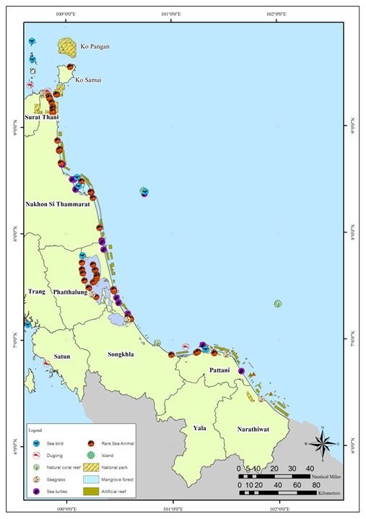
Prevention Technologies
Spill Modelling
Conducted over several likely spill scenarios under project conditions
Results should include concentration ranges expected throughout the water column (i.e., 3-D Models)
Use high-resolution models
GEMSS
NOAA
Resources at Risk Mapping
Conducted prior to project start
Part of comprehensive National Plan
GIS/Interactive based maps

Slide 8
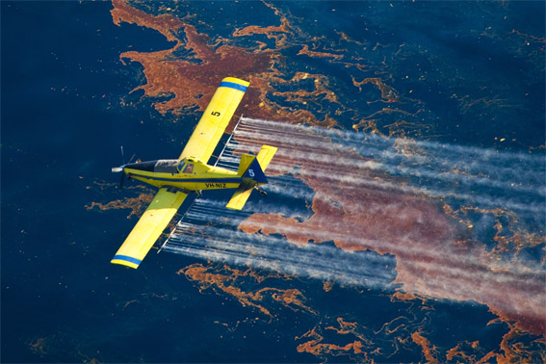
Prevention Technologies
Tactical Response Plans
Location of pre-positioned equipment
Oil Boom
Dispersant
Decontamination equipment
Waste handling materials
Response contacts
Regulatory
Project Owner
Consultant Base
Shoreline Clean up and Assessment Teams
Oil Spill Conferences
Clean Conferences – Pacific, Caribbean, Gulf of Mexico www.cleanpacific.org www.cleancaribbean.org www.cleangulf.org
International Oil Spill Conference www.iosc.org

Slide 9
Mitigation
The world’s leading sustainability consultancy

Slide 10
Mitigation Practices – Restoration
All impacts are not avoidable.
Mitigation Measures are designed to lessen or offset the impact of project activities that cannot be avoided
Restoration
Replaces lost habitat or service loss
Can be at the project site or offsite
Generally in a 1:1 or higher ratio
Does not have to be like-for-like restoration but should provide the same level of service
Habitat Equivalency Analysis (HEA)
Resource Equivalency Analysis (REA)
Opportunity for Joint Industry/Agency/NGO project partnerships.
Coastal America – Wetlands Projects
www.coastalamerica.gov

Slide 11
Mitigation Practices – Mitigation Bank
Mitigation Banking
Used to offset the impacts to a public resource after impacts are determined.
Mitigation bank is set up by resource agencies to sell “mitigation credits” to developers whose projects will impact the resource
EXAMPLE: Wetlands impacted by O&G Exploration
Proposed project would impact 100 Hectares (ha) of wetland
Agency would set up mitigation bank and sell mitigation credits in units of 1 ha
Developer needs to offset the of impact of a different project
Developer would then buy mitigation credits rather than do the restoration work
The number of mitigation credits would be determined by consultation with the agency.
Agency would use mitigation bank funds to restore the 100 ha wetland impact after all funds were in place through the mitigation bank.
This has been used extensively in the US by Federal and State Agencies to provide restoration mitigation under a variety of circumstances

Slide 12
Mitigation Technology – HEA
Habitat Equivalency Analysis
Developed by NOAA to determine the appropriate size of compensatory restoration (CR) projects for Natural Resource Damage (NRD) Assessments
Habitats provide services to other natural resources (e.g., wetlands provide food and protection for juvenile fish)
“Losses” occur when services are reduced by injuries or destructive activities
“Gains” occur when services are increased by restoration or enhancement actions
Estimates net environmental impacts, accounting for both service losses and gains
Includes both short-term and long-term service gains and losses

Slide 13
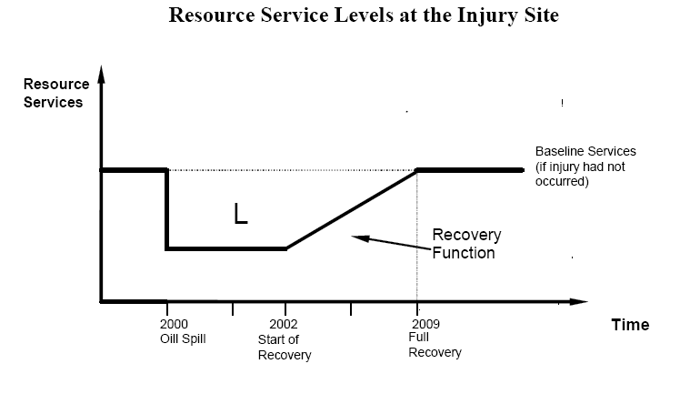
Mitigation Technology – HEA
Measurement of Service Losses

Slide 14
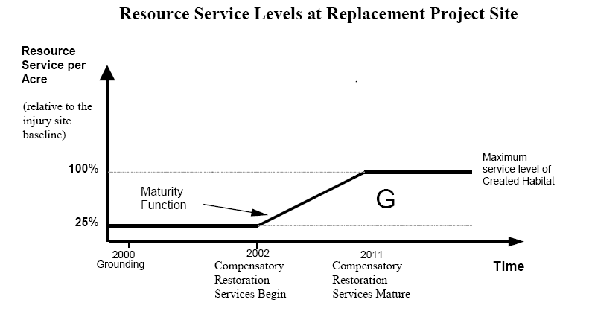
Mitigation Technology – HEA
Measurement of Service Gains

Slide 15
Monitoring
The world’s leading sustainability consultancy

Slide 16
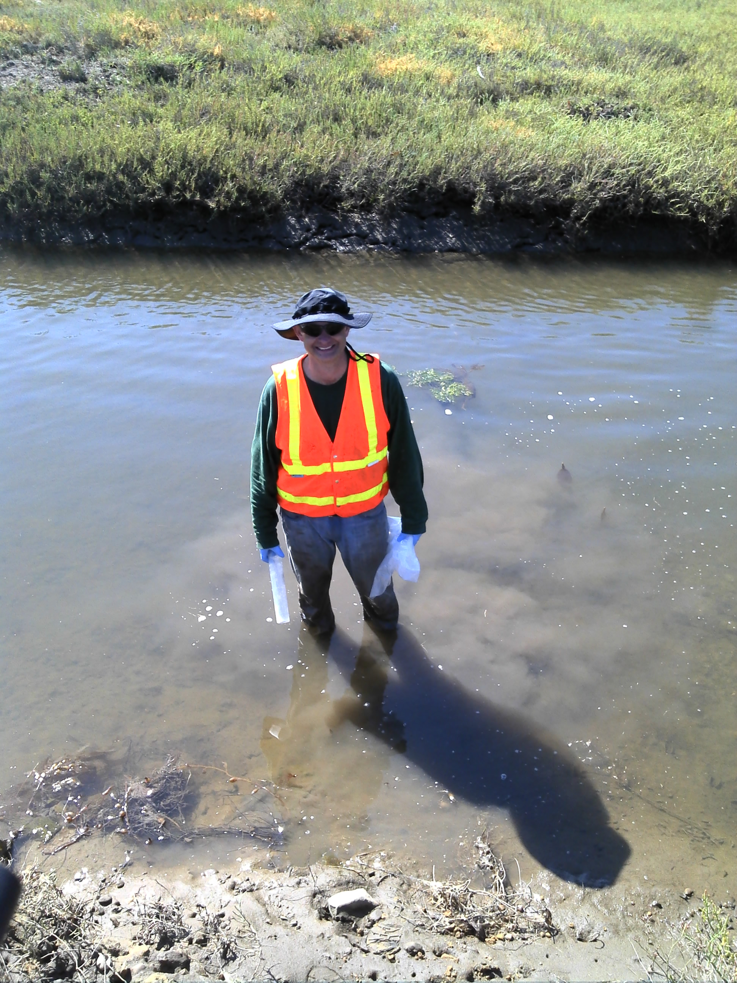
Monitoring Practice – Understanding Baseline
Knowing the baseline environmental conditions before a project begins is vital to being able to understand impacts.
Key aspects of a good baseline study
Impact and Control sites
Focus on regional issues
Multiple seasons
Multiple stations within a site
Broad array of sample types
Chemical Hydrocarbon Fingerprint
Sediment
Water
Biological
Ecological
Tissue

Slide 17
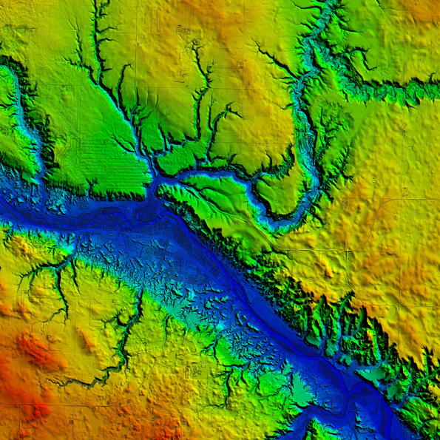
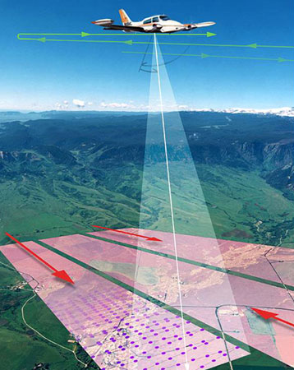
Monitoring Technologies – LIDAR
Light Detection and Ranging (LIDAR) is used to provide wide area data on elevation of wetlands.
It penetrates shallow water bodies and provides general coverage estimates of plants.

Slide 18
Conclusions
Prevention activities will minimize impacts before they happen and will prevent damage if they do
Impact Assessment
Project and Response Planning
Because all impacts cannot be avoided, mitigation measures will lessen the net impact
Restoration
Mitigation Banking
HEA
Monitoring activities and development of robust environmental baseline data will provide evidence of impact level and severity

Slide 19
Effects on Wetland Function or Service
Any Questions?

Slide 20
www.erm.com

