Slide 1
Impacts of Hydrocarbon Activities on Wetlands
Paul R. Krause, Ph.D.
Knowledge Management Program
Sensitive Ecosystem Workshop Bogota, Colombia November 2012

Slide 2
Effects on Wetland Function or Service
Impact Categories
Direct Impacts - Impacts from activities that occur within the boundary of the wetlands that affect wetland function
Indirect Impacts – Impacts from activities that occur outside of the boundary of the wetlands that affect wetland function through outside influence

Slide 3
Direct Impacts
The world’s leading sustainability consultancy

Slide 4
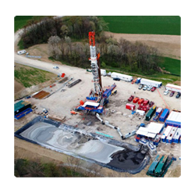
Direct Impacts of E&P Activities on Wetlands
Direct Impacts
Physical
Land
Removal of wetland habitat through development activities.
Roads
Well pad
Drilling infrastructure
tanks
oil/water separators
pipelines
Coastal facilities
housing
ports
transportation

Slide 5
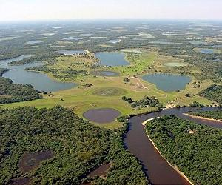
Direct Impacts of E&P Activities on Wetlands
Direct Impacts
Physical
Water
Loss or change in hydrogeology
Change in the water cycle
Removal of channels
Redistribution of channels
Increased sedimentation
Increased erosion
Restriction of flow
Loss of access
Noise
Seismic survey
Operations

Slide 6
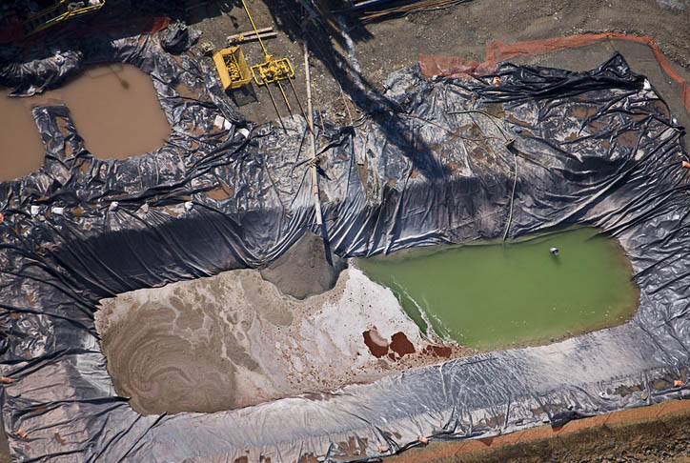
Direct Impacts of E&P Activities on Wetlands
Direct Impacts
Chemical
Exposure to hydrocarbons
Waste pits
Spills
Product (oil, condensate, gas)
Produced water
Drilling muds and fluids
Production chemicals
Corrosion inhibitors
Lubricants
Exposure Point
Water
Sediment
Air

Slide 7
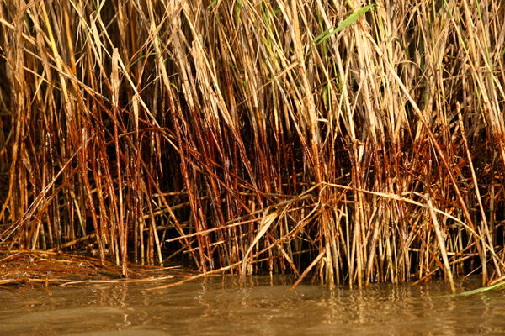
Direct Impacts of E&P Activities on Wetlands
Direct Impacts
Biological
Wetland Plants
Most wetland flora are resilient to acute hydrocarbon exposure
Uptake of oils is slow in wetland plants
Many chemicals are sequestered in plant tissue
Act as filtration system
Toxicity comes from chronic exposure
Plankton and Algae
More sensitive to acute and chronic exposure
Sensitive to changes in water quality
Early warning indicators

Slide 8
Direct Impacts of E&P Activities on Wetlands
Direct Impacts
Biological
There is a large body of toxicology work on biological impacts of hydrocarbon exposure to organisms.
Acute and Chronic Exposure
Land Animals
Adult animals are less susceptible than young to exposure of chemicals.
Exposure through direct contact of skin and fur
Exposure of young through milk
Birds
Acute exposure to adults
Exposure through eggshells
Nesting materials

Slide 9
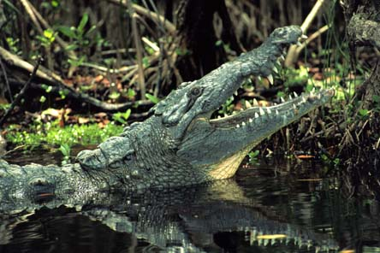
Direct Impacts of E&P Activities on Wetlands
Direct Impacts
Biological
Aquatic Animals
Fish
Very sensitive to aquatic exposure
Effects on eggs and larval fish is highest
Reptiles
Toxicology data on reptiles is limited
Crocodile and Alligator species
Exposure through eggs
Amphibians
Highly sensitive at all life stages
Exposure through skin

Slide 10
Indirect Impacts
The world’s leading sustainability consultancy

Slide 11
Indirect Impacts of E&P Activities on Wetlands
Indirect Impacts
Often have a much wider scale of impact than direct impacts
Physical
Land
Erosion caused by outside activities
Change in one area can impact far reaching areas
Erosion
Land availability
Water
Downstream exposure to aquatic systems
Beaches
Noise
Disruption of migratory corridors
Generally temporary effects

Slide 12
Indirect Impacts of E&P Activities on Wetlands
Indirect Impacts
Chemical
Spills and Discharges
Chemicals traveling downstream
Often low level chronic exposures
Chemicals impacting groundwater
Waste Pits
Chemicals in water
May affect sustainability of water systems
Chemicals in Air
Often far reaching impacts
Low level chronic exposure

Slide 13
Indirect Impacts of E&P Activities on Wetlands
Indirect Impacts
Biological
Bioaccumulaiton
Many chemicals accumulate over long periods in tissues
Occurs in plants and animals
Organics and Metals
Cancer and mutagenic effects
Biomagnification
Certain chemicals will build up in food webs
Higher concentrations with higher level predators
Exposure through uptake of food and water
Acute and chronic effects
Well documented in scientific literature
Often low level chronic exposures

Slide 14
Conclusions
Hydrocarbon exposure through oil and gas exploration activities in wetlands can take place through both direct and indirect pathways
Physical, chemical, and biological effects are expected
Wetland plants are often resilient to direct exposure and may act as a biological filter for exposures
Effects are often most evident in eggs and juveniles
Effects can be managed effectively for wetland exposures through mitigation measures and monitoring.

Slide 15
Effects on Wetland Function or Service
Any Questions?

Slide 16
www.erm.com

